Slide 1
INTRODUCTION TO
SOFTWARE ENGINEERING

Slide 2
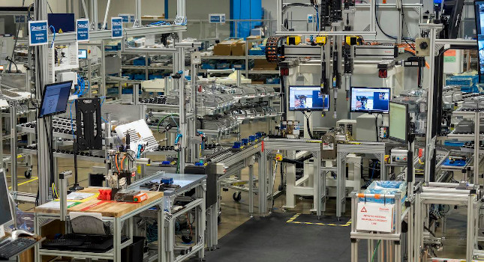

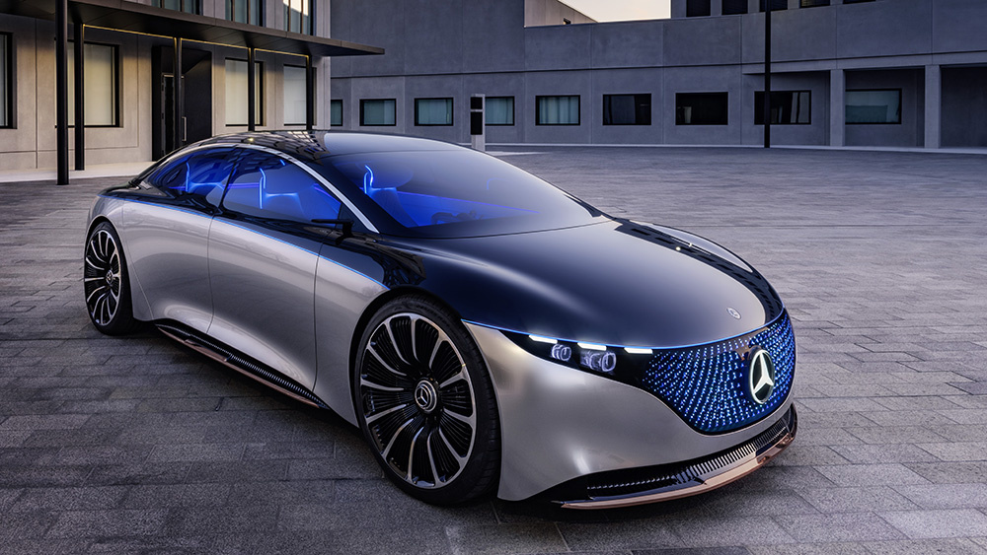
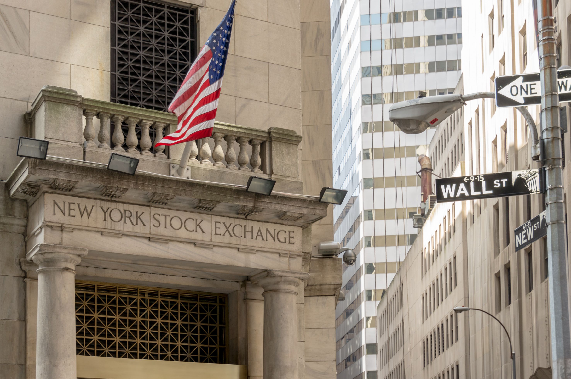
Look at the Pictures… What do you see?

Slide 3
What do they have in common? Or, what you don’t see?
Code
(and lots of It)
Notes:
1

Slide 4
Looking at it in more detail
A Boeing 747 has more lines of code than the parts of the aeroplane including nuts and bolts
~ 5 Million lines of Code
Most Games have
~ 6 Million or more lines of code
(and this has to be done on different systems and different OSs etc.)
Notes:
1

Slide 5


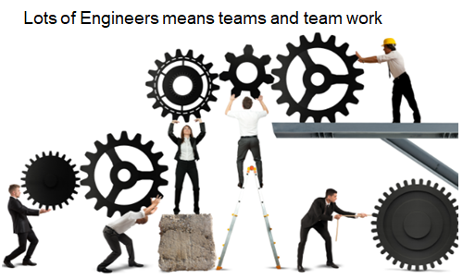
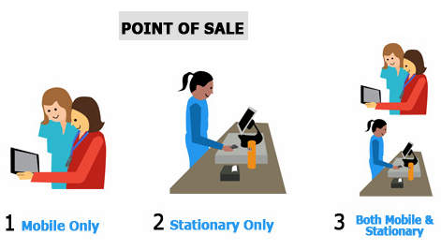

Leading to
Need for interacting with customers and other stake holders on what is their requirements/needs
Need for understanding how is this going to be used, and by whom
Need Experts in different domains to support this (Cross-domain)
Need for good Planning
Need for good Teamwork
Need to have an ability to scale/support
Lets assume an Engineer can code 1 LOC a min
Then
1 LOC/min * 60 min/hr = 60 LOC/hr
Say for 40 hrs/Wk, 60*40 = 2400 LOCs/week/SE
-> 2400 LOC/week * (~)45 = 1,08,000 LOCs/Yr/SE
So lots of engineers will need to be working for long period of time
Notes:
1

Slide 6
Some Definitions…
What is Software?
What is a Software Product?
What is Software Engineering?
Notes:
Software is not manufactured in the classical sense and does not wear out.
Software may be
Generic software - developed to be sold to a range of different customers e.g. PC software such as Excel or Word.
Custom software - developed for a single customer according to their specification.
System Software – designed to operate/manipulate hardware
Application software – developed to perform any task/function that benefits from computation
Programming Infrastructure software - Programs or applications that software developers use to create, debug, maintain, or otherwise support other programs and applications.
New software can be created by developing new programs, configuring generic software systems or reusing existing software or piecing together different software.
1

Slide 7
Given all of this context
If we look at some of the definitions involved
Software can be collection of executable computer programs (code), their configuration files and associated libraries and their documentations serving a computational purpose.
Software Product is Software when made for a specific or specific group of requirements
Software can include prefixes as Generic, Custom, System and Application
Engineering is all about acquiring and using well defined scientific principles and systematic methods for developing products, with economic sense, social perspective and practical considerations.
Involves making decisions or making choices given a context
Notes:
Software is not manufactured in the classical sense and does not wear out.
Software may be
Generic software - developed to be sold to a range of different customers e.g. PC software such as Excel or Word.
Custom software - developed for a single customer according to their specification.
System Software – designed to operate/manipulate hardware
Application software – developed to perform any task/function that benefits from computation
Programming Infrastructure software - Programs or applications that software developers use to create, debug, maintain, or otherwise support other programs and applications.
New software can be created by developing new programs, configuring generic software systems or reusing existing software or piecing together different software.
1

Slide 8
Software Engineering (SE)
Software Engineering is the systematic, disciplined, quantifiable approach towards the development, operation, and maintenance of software products.
A software product developed using Software Engineering principles has a higher probability of being efficient and reliable.
Software Engineering principle drives usage of appropriate tools and techniques depending on the problem to be solved, while considering the constraints and resources available
Focuses more on techniques for developing and maintaining software that is correct from its inception
Notes:
Software engineering is beyond programs people write for something/hobby
Software engineering is an engineering discipline that is concerned with all aspects of software production.
Software engineering can also be looked at as the systematic and scientific approach to develop, operate, maintain and to retire the software product. Software product could be interpreted as software for a large/medium size complex problem.
Software engineering is imperative in a large project, though there are benefits and can/and is good to be used for the development of programs/small assignments.
1

Slide 9
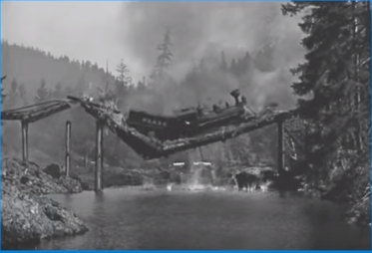
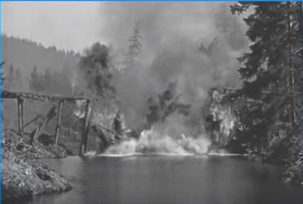
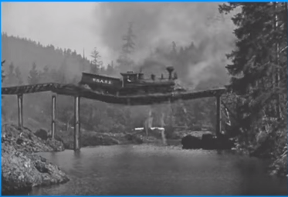
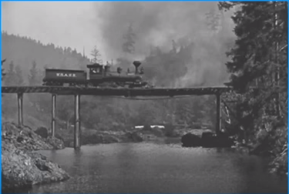
Is Computer Science == Software Engineering ?
Both of them solve problems using code but how they go about are different
E.g. A bridge collapse
Scientist build something to learn something new
Whereas
Engineer learns things to design and build quality products
Is it Scientist’s problem or an Engineering problem
Scientists want to achieve scientific breakthroughs
Whereas
Engineers want to avoid engineering failures
Notes:
1

Slide 10
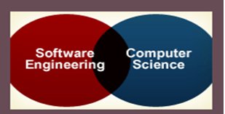
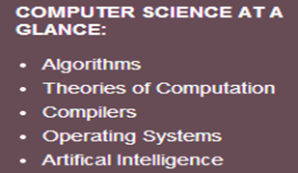
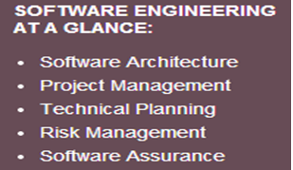
Is Computer Science == Software Engineering ?
Content differences:
Computer science
Focuses on foundations of computing including, algorithms, programming languages, theories of computing, artificial intelligence,.., and some hardware design.
Software engineering
Focuses on technical and managerial leadership for large and complex systems
It’s the foundation of enduring engineering principles which will support a lifetime of practice, amid emerging technologies.

Slide 11
Fundamental Drivers of Software Engineering (the Why’s)
Industrial Strength Software
Software is Expensive
Late and Unreliable
Can influence the life and death of a person
Heterogeneity
Diversity
Business and Social change
Security and Trust
Scale
Quality and Productivity
Consistency and Repeatability
Notes:
1

Slide 12
Fundamental Drivers
Industrial Strength Software
needs to be
Operational : Functionality, Usability, Correctness …
Capable of being moved: Portability, Interoperability ..
Maintainable: Modularity, Maintainability, Scalability ..
have elaborate Documentation
absence/minimal number, of bugs is of primary importance
are Impactful to the business's leading to the need for strong processes for quality and resiliency
Notes:
1

Slide 13
Fundamental Drivers
Software is Expensive
Software is labour intensive, Industrial-strength software is very expensive
Each line of code can cost from $5 to $35 when calculated across the lifecycle could go as high as $400
Software also has loads of Maintenance and Rework which costs money
Maintenance could be corrective, adaptive or rework
Includes cost of Hardware-Software-Maintenance
Notes:
1

Slide 14
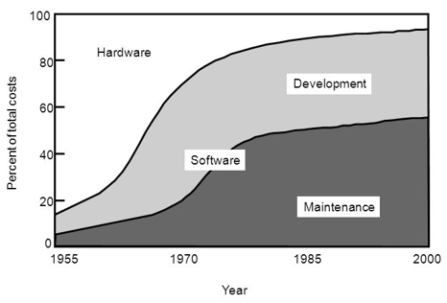
Relative distribution of software/hardware costs
Notes:
https://www.youtube.com/watch?v=H2tuKiiznsY&authuser=1
1

Slide 15
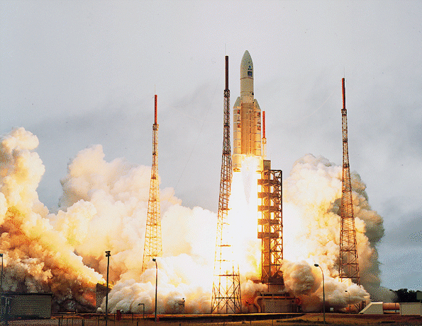
Fundamental Drivers
Late and Unreliable
Typically 35% of the computer based projects are runaway
70% of equipment failure in Defence is considered due to software
E.g. NASA Rocket Failure
Notes:
1

Slide 16
ARIANE Flight 501
Disintegration after 39 sec
Caused by large correction for attitude deviation
Caused by wrong data being sent to On Board Computer
Caused by software exception in Inertial Reference System after 36 sec
Notes:
© SE, Introduction, Hans van Vliet
1
This was the maiden flight of the Ariane 5.
The Inertial Reference System determines the position of the rocket and its movements in space. It has its own computer, which computes angles and speeds based on information it gets from the ground station, lasers, etc. There are 2 IRS’s, which both failed.

Slide 17
The details
Overflow in conversion of variable BH from 64-bit floating point to 16-bit signed integer
Of 7 risky conversions, 4 were protected; BH was not
Reasoning: physically limited, or large margin of safety
In case of exception: report failure on data-bus and shut down
Notes:
© SE, Introduction, Hans van Vliet
1
BH - horizontal bias
Not all conversions were protected, for performance reasons

Slide 18
Possible explanations
Inadequate testing
Improper reuse
Wrong design philosophy
Further Information if interested
IEEE Computer, jan. 1997, p. 129-130
http://www.cs.vu.nl/~hans/ariane5report.html
Specification did not contain Ariane 5 trajectory data as a functional requirement
In tests, the SRI’s (components that measure altitude and movements of the launcher) were simulated by software modules
If a component works perfectly well in one environment, it doesn’t necessarily do so in another
Ariane 5 was much faster than Ariane 4, and horizontal velocity builds up more rapidly
⇒ excessive values for parameter in question
Wish for quick alignment after hold in shutdown
⇒ this software runs for a while after lift-off. It doesn’t have any purpose for the Ariane 5, but was still kept
If something breaks down, such is caused by a random hardware failure
Action: shut down that part
There is no provision for design errors
Notes:
© SE, Introduction, Hans van Vliet
1
In a sense, all these explanations are true
This shows the complexity of issues, and the trade-offs involved

Slide 19
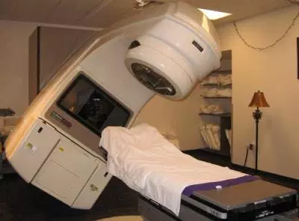
Fundamental Drivers
Can influence the life and death of a person
Therac 25 – (Radiation Therapy M/C) 6 People died due to over exposure to radiation – One cause a S/W bug
Heterogeneity
Systems are required to operate as distributed systems across networks that include different types of computer & mobile devices.
Diversity
There are many different types of software systems necessitating different techniques, methods and tools.
Business and Social change
Changes are happening quickly with economies & organizations getting more global, and availability of new technologies. Organizations need to have the ability to change their existing software to rapidly develop new S/W
Notes:
1

Slide 20
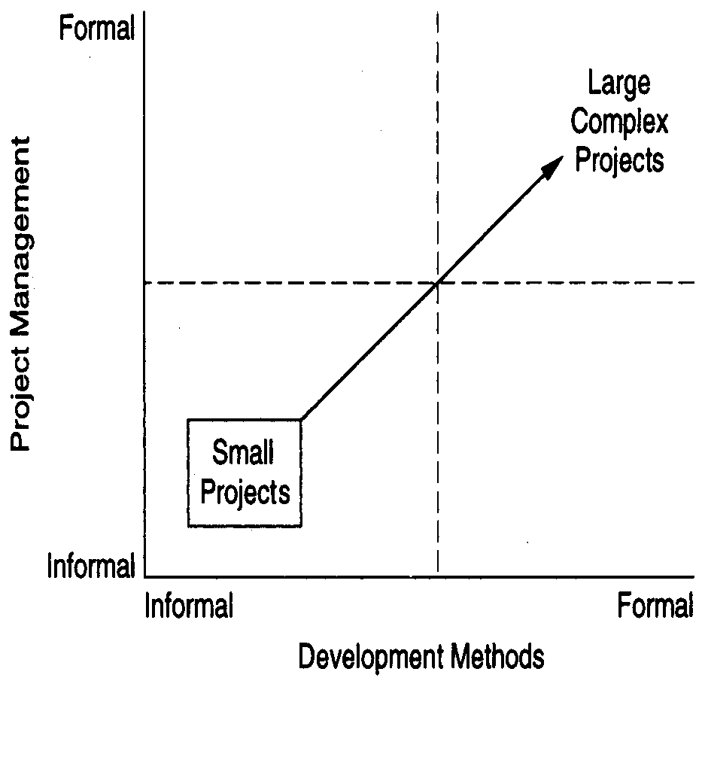
Fundamental Drivers
Security and Trust
SW is intertwined with all aspects of our lives, it is essential that we can trust that software
Scale
Processes and methodologies needs to scale easily with size
Quality and Productivity
Software quality which could be looked at as FLURPS+(efficiency or Maintainability) + Portability
Consistency and Repeatability
Notes:
Functionality Localizability Usability Reliability Performance Supportability
Questions on relevance of software engineering practice
Increasing Open Source Movement leading to questions on some of the engineering processes
1

Slide 21
Summarily Software Engineering is for
Development of BIG programs Mastering complexity of these Large programs/Systems Development of Software that is Evolving Efficient development | Supporting large teams, teamwork and global development Ensuring a process through which software being developed, supports the users effectively Ensuring that the right choices or decisions are made while working under constraints or supports the balancing act Ensuring the needs of visibility and continuity
Notes:
© SE, Introduction, Hans van Vliet
1
- Space Shuttle software: 40 million lines of code
- complexity often is not “mathematical” complexity, but caused by the myriad of details to be handled
- reality changes, so the software has to change as well (e.g. salary administration and changing tax regulations)
- software costs a tremendous amount of money (it is very labor intensive)
- OS 360 cost 5000 person years (so you need rules and regulations - hence process models)
- so user involvement
- software engineers tend to have little knowledge of the application domain

Slide 22

Comparison with Cooking…
Notes:
© SE, Introduction, Hans van Vliet
1

Slide 23
Course Content
Introduction, Requirements Engineering and Project Management
Architecture and Design (with Object Oriented Analysis and Design)
Development and Implementation
Software Testing, Quality and Ethics
IT Services Management and Dev Ops
Notes:
© SE, Introduction, Hans van Vliet
1

Slide 24
Evaluation Policy
ISA 1 ( 60 marks reduced to 25 marks )
ISA 2 ( 40 marks reduced to 15 marks )
Quiz ( 10 marks )
ESA ( 100 marks reduced to 50 marks )
All assessments (except Quiz) will be conducted in Pen and Paper mode.
Notes:
© SE, Introduction, Hans van Vliet
1

Slide 26
Introduction to Software Engineering

Slide 27
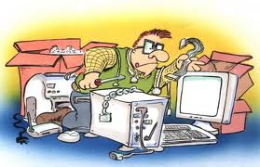
Introduction to Software Engineering
Evolving into a software development lifecycle & process
Phalachandra H. L
Department of Computer Science

Slide 28
House Construction Lifecycle
Could you think of the steps involved in the construction of a House
Notes:
Create a Budget for Building Your Home. ...
Buy Some Land. ...
Plan Your Home's Layout. ...
Find a Builder and an Architect. ...
Floor Plan.
Elevation 3-D.
Structure Drawings.
Working Drawings.
Electrical layout.
Plumbing layout.
Drainage Drawings.
1

Slide 29
House Construction Lifecycle
You realize that you have the means or you have a want or you want to save money on rentals and think you want to build your own house
Collect information on the where you want to build it and the cost of site, cost of building, commute, ambience, green, investment. - distance to family/friends, etc.
Analyse whether it makes financial sense – rental/loan repayment/interest which can be earned ..
Hire a broker .. look at sites and select a site and buy a Site
Hire an Architect to evolve an conversion/rendering of your dream to an implementable Plan.
Meetings between you and the Architect to describe what you want
Includes what you want it to look like
Features to be included
Architect draws up the rendering/models/drawings - elevation/plans
Interactions between you and architect and the requirements are finalized post relooking at renderings/models/drawings and get regulatory approvals
Time plan with what are different specializations needed and dependencies are identified .. Scope – Schedule - Resources
Decision Made

Slide 30
House Construction Lifecycle
Architect – and you together identify and hire a contractor to build a house .. additional specializations like leads towards a structural engineer, plumbing, electrical, carpentry etc.
Architect provides different views and drawings/requirements for each of the person Electrical drawing, Plumbing drawing, Structural diagram etc.
Further discussions, changes and everyone agrees to the plans and parallelly contractor begins constructing the house
In between you would visit the site and indicate changes you would like .. Several changes and then house is constructed
There are different phases .. Columns, rest of Foundation, Walls, Roof, Plastering .. dependencies and implementation
Contractor believes its complete .. Has each of the things checked independently as a unit by the respective actors … electrician has checked wiring - points, plumber has checked for leakages … etc .. painter has done his parts etc.
Contractor (and maybe you too) look to see after all of them have completed (Integration and as complete function as a system) are there issues which are cropping up .. say wires showing up .. missing cable or network points or door being obstructed .. something not being able to be closed etc.
Before you move in, you go out to check several things (Switch too close to wardrobe and not easy to operate, Switch not next to the door etc.. ) (User acceptance testing) and then accept and do .. Grihapravesha ..
Initial hiccups when you would call the contractor A .. water not getting drained away .. and then you move in.
Now you are responsible for the house and you maintain the house later by calling the respective plumber etc.

Slide 31
House Construction Lifecycle
So we could describe this as
Initiation (budget, site, architect)
Initial requirements and feasibility
Crystallization of requirements, needs, wants working with architect
Need to consider the Social, economic and government regulations like offset .. Social expectations/constraints (.. Vaastu .. Agni.. Etc.)
Designing and Planning (plans, layouts, contractor, approvals)
Execution – Build, Monitor
Completion – testing and verification
Acceptance by you
Move in and fixing initial issues with modifications after the residents have moved in
Continuing maintenance by the residents of the house

Slide 32
House Construction Lifecycle
Few things to keep in context
You could get into the steps of constructing based on understanding the feasibility and decisioning to go ahead.
There could have been multiple rounds of discussions, validating your requirements, rendering/converting of your dream into a set of requirement which could be acted on.
Since there are number of stakeholders contributing to ensure that they all are working towards the same goal .. Lots of diagrams with different views details, designs, plans are done and shared [Documentation]
Give that everything is not easily visualizable, there may be changes, refinements which might need to be done during the construction of the house. Say like
Sky light or a anteroom etc
Cost escalations which may need to reduction of scope
Non-availability of some material leading to change in the plan etc

Slide 33
House Construction Lifecycle
You would definitely not want to finalize the plan and come back in the end to see the house .. You want to come in periodically see the progress which gives better understanding .. Which may need to make changes which needs to be done as and when and not waited till the end.
You would like to see the house after different phases of execution of the construction
Columns are constructed
Foundation is done
Lintel and after the walls and before the roof is done
Once after the supports are removed and the electrical and plumbing points are identified
Once carpentry is done before final painting …etc
Validation at different levels, Acceptance and Maintenance

Slide 34
A simplistic view of a Software Development Lifecycle
Project Management
problem
Elaborate the problem
requirements
req specification
Architect/design
Design document
implement
System which works
test
Functional system
maintenance

Slide 35
The software Lifecycle
Software Process (is also called Lifecycle or process model or lifecycle model)
Involves structured set (procedure/recipe) of activities (steps or phases mostly in a particular order) producing intermediate and final products
Every lifecycle step has a guiding principle that explain the goal of each phase. E.g. Requirements Engineering defines what the system should do.
Each of the steps in a phase can be a process by itself
Products are outcomes of executing a process (or a set of processes) on a project
1

Slide 36
The Software Lifecycle
Each of these activities/steps/phases produces an intended output of some kind, required to develop a software system and either implicitly/explicitly has :
Entry criteria : What conditions must be satisfied for initiating this phase
Task and its deliverable: What should to be done in this phase
Exit criteria : When can this phase be considered done successful
Who : Who is responsible
Dependencies : What are the dependencies for this phase ..etc.
Constraints : e.g. Schedule

Slide 37
The Software Process
Structure allows us to examine, understand, control and improve the activities in the process
There are other relevant processes like management process, configuration management process, change management process, Inspection process etc. which are part of the Software Development too

Slide 39
Introduction to Software Engineering

Slide 40
SDLC, PDLC, PMLC & SMLC

Slide 41
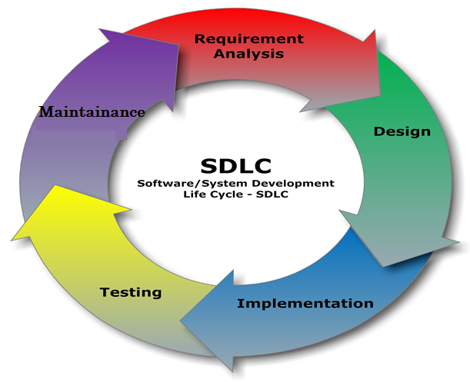
SDLC (Software Development Lifecyle)
- Feasibility Study - Requirements
- Architecture - Design

Slide 42
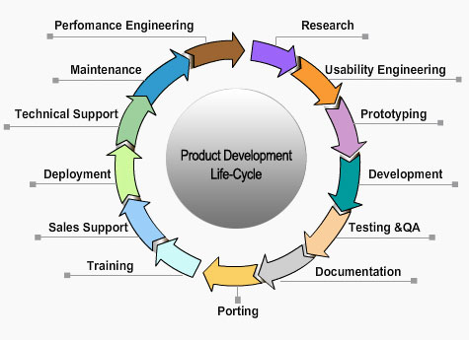
PDLC (Product Development Lifecyle)
Using a different lifecycle
Requirements Engineering
Architecture
Design
(Iterate and refine prototype)
Implementation

Slide 43
Project Management in System Dev Lifecycle
Initiation, Planning and Organization
Feasibility Analysis
Project Plan: Product, Schedule, Budget, Tasks
Requirements Engineering
Architecture & Design
Project Execution, Direction and Control
Implementation
Testing
Closure, Project review and process improvement
Operation & Maintenance

Slide 44
Software Maintenance Lifecycle
Problem/Modification /Enhancement
Delivered S/W component
Problem/Task Identification
Delivery (Patches, Releases)
Identified problem
Analysis
System, Regression, Acceptance Testing
Impact, Criticality, Priority
Approval for change
Review/Unit Test Change
Design the Change
Implement the change

Slide 45
Product Lifecycle
Attributes to Consider
Market capitalization
Sales
Investment
Competition
Profit
Support
Product built using a SDLC is initially released into market
Introduction
Growth
Maturity
Discontinuance
Obsolescence

Slide 46
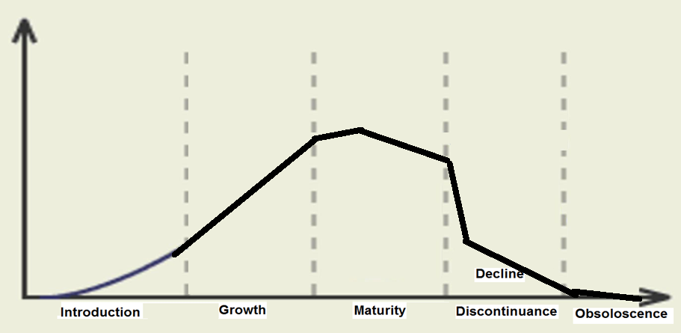

Product Life Cycle Characteristics
INVESTMENT
SALES / REVENUES
TIME
Notes:
1

Slide 48
INTRODUCTION TO SOFTWARE ENGINEERING

Slide 49
Legacy SDLCs : Waterfall, V Model, Prototyping, Incremental and Iterative Models

Slide 50
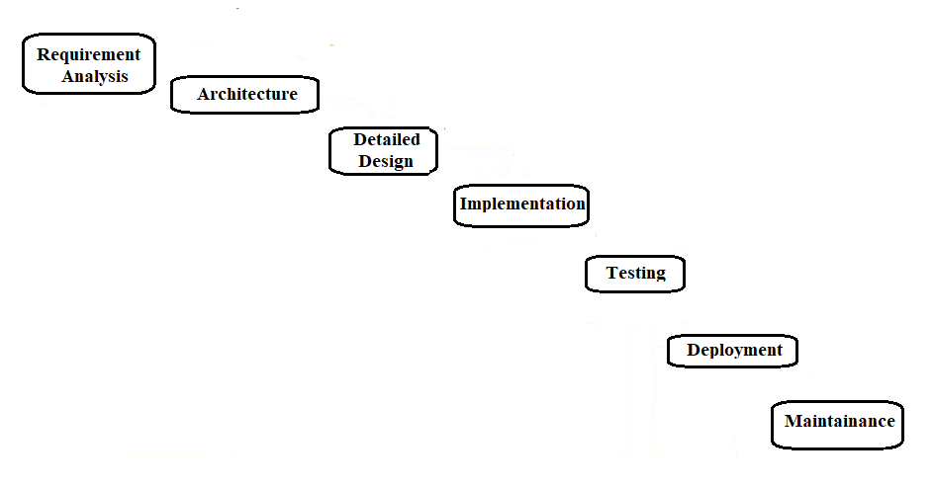
Waterfall Model

Slide 51
Waterfall Model
Advantages Simple Clear Identified phases as shown and easy to departmentalize and control Easy to manage due to the rigidity of the model Each phase has specific deliverables and a review process Dis-Advantages | Assumes requirements (both user & hardware) can be frozen Difficult to accommodate change and hence not very flexible Sequential. Move from one phase to another only after the completion of the previous phase Big bang approach .. No working software till late in the lifecycle High risk and uncertainty Poor model for long and ongoing projects

Slide 52
Waterfall Model
Usage
Used (in pure form) for short projects where requirements are well understood
Variants are used at a high level in large projects
Product definition is stable and technology understood
Variants used in large globally developed projects with other LC

Slide 53
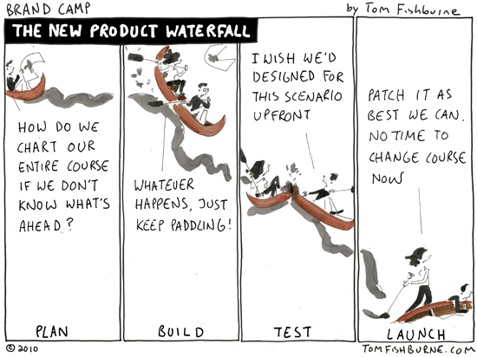
Waterfall Model

Slide 54
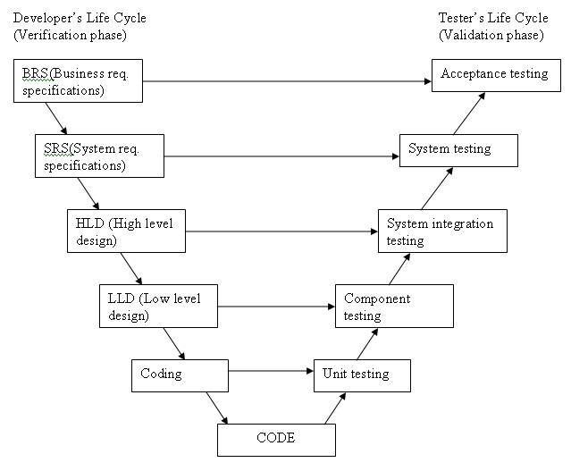
V Model
BRS (Business req specification)
User req

Slide 55
V Model
Advantages Similar to waterfall model Test development activities like test design and static testing can happen before coding and the formal testing lifecycle Higher probability of success Dis-Advantages Similar to waterfall model | Software is developed during the implementation phase, so no early prototypes of the software are produced. Change through the process, necessitates changes in test documentation too. Usage Similar to waterfall model

Slide 56
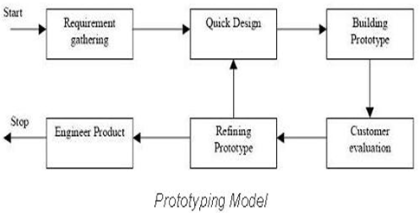
Prototyping
Prototyping should be a relatively a cheap process (subset, non production quality etc.)
Instead of freezing the requirements before a design or coding can proceed, a complete system prototype (with no or very less details) is built and to understand the requirements
Throw-away and evolutionary prototypes

Slide 57
Prototyping
Advantages :
Active involvement of the users
Provides better risk mitigation (cost, understanding of the user requirements)
Problems/defects are detected earlier and hence reduces time and cost
Missing functionality easily identified and hence resulting system is full featured
Systems are mostly more stable
Dis-Advantages:
Practically, this methodology may increase the complexity of the system as scope of the system may expand beyond original plans
Performance of the resulting system may not be optimal

Slide 58
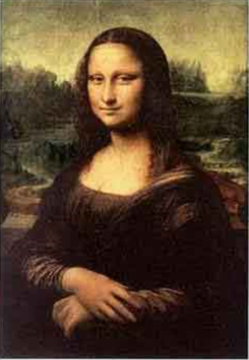

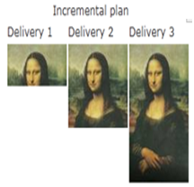


Incremental Model
In this model requirements are partitioned and an incremental plan is made for delivery
Working version of software is produced during the first module, so we have a working software early on in the software life cycle.
Each subsequent release of the module adds functionality to the previous release.
This continuous integration continues till the complete system is achieved.

Slide 59
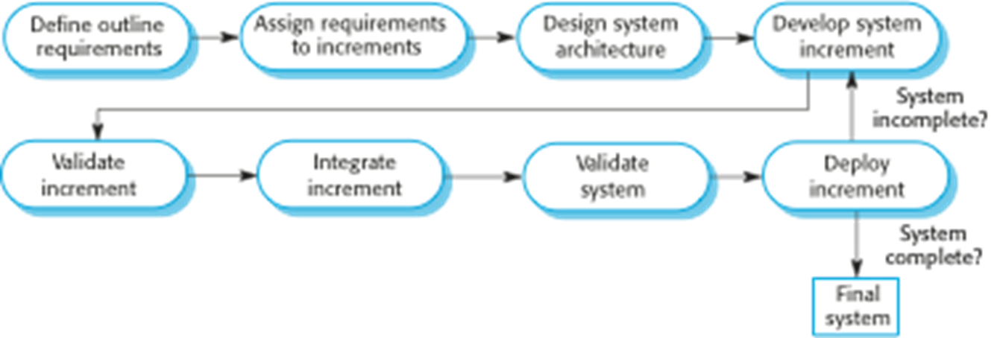
Incremental Model
The partitioned requirements can each have a development lifecycle
Models like waterfall could be used/employed for each of the partition/increment
Leveraged prototype for additional features would be a form of incremental model

Slide 60
Incremental Model
Advantages :
Customer value – as early versions can be delivered to customers
More flexible – less costly to change scope and requirements as, early increments act like prototypes
Easier to test and debug during a smaller iteration.
Easier to manage risk .. risky pieces are identified and handled during iteration ..customer can respond to it .. no big bang
Continuous increments rather than monolithic
Reduces over-functionality. Essential features first and additional when needed
Dis-Advantages:
Needs good planning and design
Needs clear and complete definition of the whole system before it can be broken down and built incrementally
Total cost is higher than waterfall.
Hard to identify common facilities that are needed by all increments
Management visibility is reduced which could lead to surprises

Slide 61
Incremental Model
Usage :
In projects where major requirements are defined (although some details can evolve with time)
When there is a need to get a product to the market early.
When a new technology is being used
Resources with needed skill set are not available
There are some high risk features and goals.

Slide 62
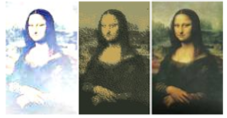
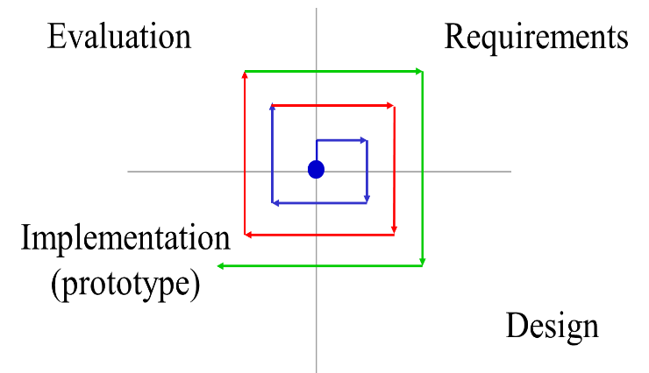
Iterative Model (Evolutionary)
Initial implementation attempts to start with a skeleton of the product, followed by refinement through user feedback and evolution until system is complete.
Built with dummy modules
Rapid prototyping
Successive refinement
Advantages
Helps in identifying requirements, visualization of solution
Supports risk mitigation
Redesigning/Rework and defect flowing down the process is reduced
Incremental investment

Slide 63
Iterative Model (Evolutionary)
Disadvantages
Each phase of an iteration is rigid with overlaps
Costly system architecture or design issues may arise because not all requirements are gathered up front for the entire lifecycle
Usage:
Large projects

Slide 64
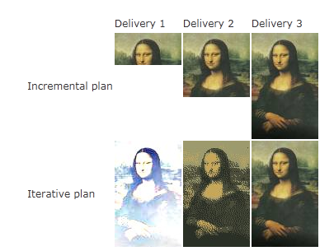
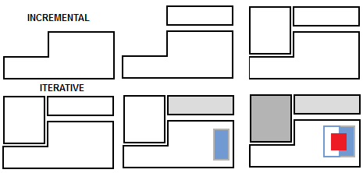
Contrasting Incremental and Iterative Models
Incremental approach does not require going back and changing things that are already delivered whereas Iterative continues to revisit and refining everything every time
Incremental focuses on things not implemented, whereas Iterative is more details of the same
Incremental does not leverage on the experience/knowledge till then, whereas iterative leverages learning's.

Slide 66
Introduction to Software Engineering

Slide 67
Agile Philosophy

Slide 68
Limitations of most legacy Lifecycles
Traditional models are based on predictive software development methods
Upfront planning
More suitable where there is a clear definition of what needs to be achieved and things are not changing fast
Models do not facilitate periodic customer interactions
Suited for very large projects with complex dependencies
Suitable for some kinds of organizational environments like global, distributed, to some organizational structures etc.
Product lifecycle and its eco-system
People and Skill perspectives
Regulatory perspectives

Slide 69
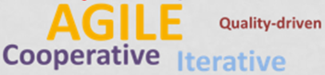
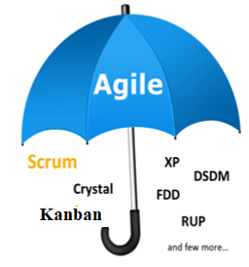

Agile
“Agile" is an umbrella term used to describe a variety of methods that encourage
Continual realignment of development goals with the needs and expectations of the customer.
Its also aimed at reducing massive planning overhead to allow fast reactions to change.
CONTEXT
World is chaotic
Change is inevitable and is the constant
Deliver value to customer as quickly as possible

Slide 70

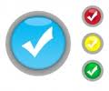



read - Is valued more than
Agile Manifesto
Individuals and interactions over Processes and tools
Working software over Comprehensive documentation
Customer collaboration over Contract negotiation
Responding to change over Following a plan
Focus on Simplicity in Both the product and the process
Notes:
verbal declaration of the intentions, motives, or views of the issuer
1

Slide 71
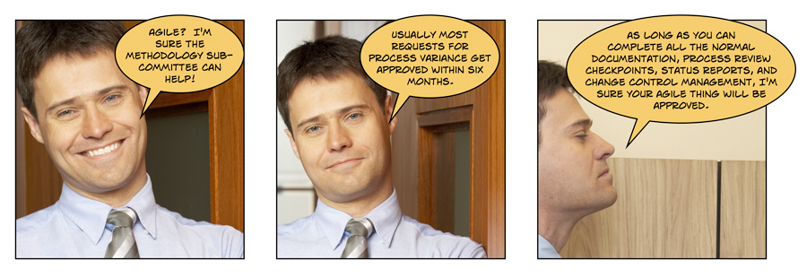
Pun on Agile

Slide 72
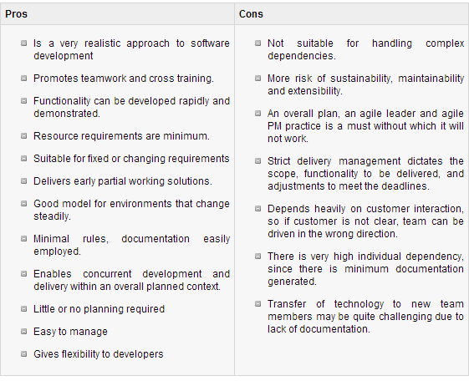
Agile Methodologies

Slide 73
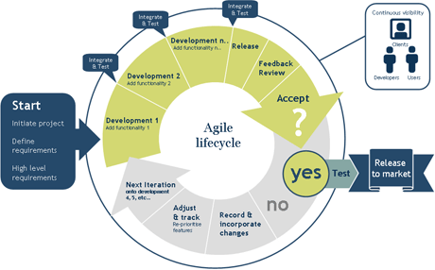
Agile based Lifecycles

Slide 74
SCRUM
Scrum is an agile methodology or framework for developing, delivering and sustaining software components and products
Scrum is an iterative approach towards software development
Scrum words comes from rugby where it’s a formulation of play where everyone has a part and you huddle periodically to take stock
Scrum provides mechanisms to apply agile practices
Scrum is defined by
Roles
Events (ceremonies)
Artifacts
Rules

Slide 75



SCRUM : Roles
Organization is split into small, cross-functional, self-organizing teams.
Product/ Project Owner
Scrum Master
Scrum Team
Scrum Team
Scrum Team
Scrum Team
- made up of contributors to the deliverable
- responsible for delivering shippable increments
- Self organized
- Cross Functional
Scrum Master
- not a manager
- facilitator
- removes impediments
- facilitates meetings
- ensures team adheres to scrum theory and practices
Product Owner - is the voice or rep of the stakeholder/team
Create/manages Product Backlog

Slide 76
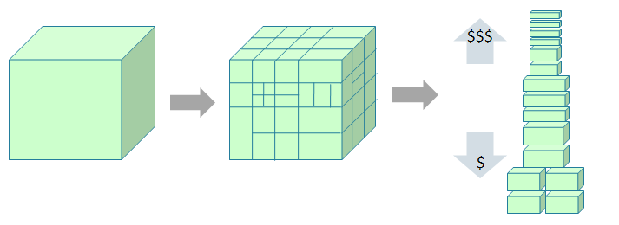


SCRUM : Artifacts
Split your work into a list of small, concrete deliverables. Sort the list by priority and estimate the relative effort of each item.
R
o
a
d
m
a
p
Product backlog
backlog as user stories
Weighted and ranked stories
The project/product is described as a list of features also called Product backlog
The features are described in terms of user stories
The scrum team estimates the work associated with each story and ranks them in the order of importance.
The weighted-ranked features/stories in the backlog results in roadmap
The features/stories in the backlog planned for a sprint is the sprint backlog

Slide 77
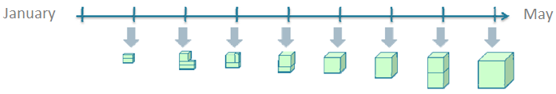
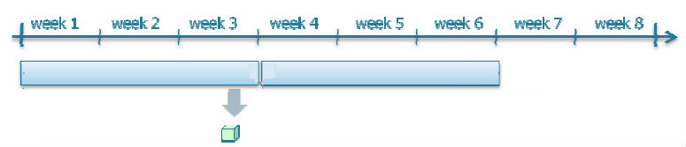
SCRUM : Events
Split time into short fixed-length iterations (called Sprints) usually 2 – 4 weeks, with potentially shippable code demonstrated after each iteration. (its also called time-boxing)
Iteration/ Sprint 1
Iteration/ Sprint 2
The total effort each iteration can accommodate leads to number of user story per iteration
Release
One release may contains number of iterations
Sprint planning meeting is the planning meeting to determine which of the product backlog items will be worked on and delivered in the sprint iteration
Notes:
1

Slide 78
SCRUM : Events
Daily scrum meeting or Standup meeting to discuss
What did you do yesterday?
What will you do today?
Any obstacles?
End of the sprint has a finished “shippable product”
Sprint review meeting demonstrates story features. Product owner evaluates against preset criteria's. Gets feedback from clients and stakeholders and ensures the delivered increment meets the business need and helps support reprioritizing of the product backlog and optimize the release plan if needed.
Optimize the process by having a Sprint retrospective after each iteration. It is the final team meeting in the Sprint to determine what went well, what didn't go well, and how the team can improve in the next Sprint. Attended by the team and the ScrumMaster, the Retrospective is an important opportunity for the team to focus on its overall performance and identify strategies for continuous improvement on its processes.

Slide 79
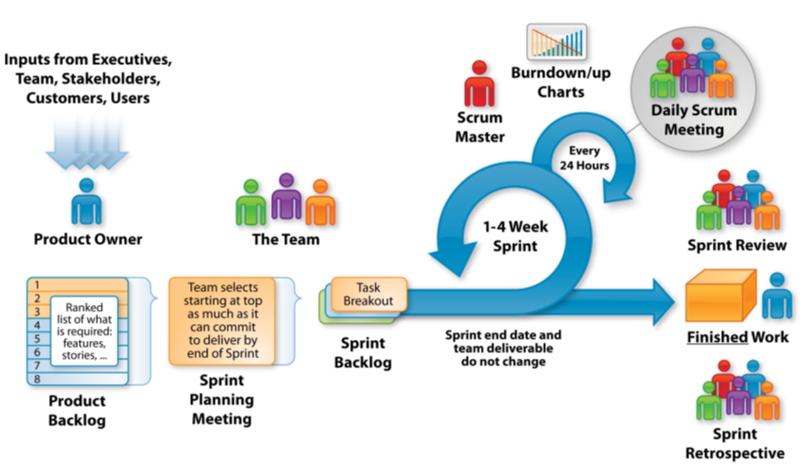
SCRUM : In a nutshell
So instead of a large group spending a long time building a big thing, we have a small team spending a short time building a small thing but integrating regularly to see the whole

Slide 80
SCRUM : Summarizing the framework
Scrum is a lightweight agile framework with broad applicability for managing and controlling iterative and incremental projects of all types.
Demos can be provided after every Sprint
Small working teams to maximize communication, minimize overheads, sharing of tacit and informal knowledge
Adaptable to technical and business changes
Yields frequent software increments that can be inspected, adjusted, tested, documented and built on.
Development work and people who perform it are partitioned into clean low coupling partitions/packets
Constant testing and documentation is performed as the product is built.
Ability to declare a product done whenever done
Teams start with simple Scrum tools like a whiteboard or a spreadsheet to manage the product backlog and the progress of the sprint backlog items.

Slide 82
INTRODUCTION TO SOFTWARE ENGINEERING

Slide 83
CBSE - Component Based Software Engineering

Slide 84
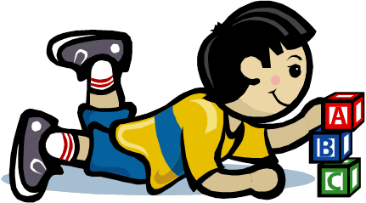
Lego
Set of building blocks in different shapes and colors
Can be combined in different ways
Composition through small stubs in one and corresponding holes in another building block
⇒ LEGO blocks are generic and easily composable
LEGO can be combined with LEGO, not with Meccano or any other blocks
Common Theme
Reuse
Quickly assemble Models
Build Complex models

Slide 85
What and why CBSE
What is CBSE
Component-based software Engineering approach is a reuse based approach to define, implement or select of-the shelf components and integrate/compose loosely coupled independent components into systems
Motivation or the need for CBSE
Increase in complexity of systems
Need for a quicker TAT .. So reuse rather than re-implement and shorten development time

Slide 86
Advantages and Problems with CBSE
Advantages of CBSE Components could be used as a black box and hence reduces complexity of systems Since developers reuse components, this reduces the development time Increases quality (due to explicit dependencies, reuse) especially evolvability and maintainability Increases productivity | Problems with CBSE Component trustworthiness Component certification Emergent property prediction Requirement trade off

Slide 87
Essentials of CBSE to be successful
Independent components that are completely specified by the public interfaces (implementation is hidden and hence can be changed)
Component standards that facilitate the integration of components
Middleware that provides software support for component integration
Development process that is geared up to CBSE (interleaving of requirement and system design –trade-off requirements/existing services etc.)

Slide 88

A Software Component
Implements a functionality without regard to where the component is executing or its programming language
Its an independent executable entity that can be made up of one or more executable objects;
The component interface is published and all interactions are through the published interface;
Has explicit dependencies through “required” interfaces and “provides” (the services that are provided by the component to other components)

Slide 89
Identifying the Software Component
Identifying the components could involve
Searching for the component
Selection of the component
If there are no ready component, Compose components with existing components to create component
It could be a sequential composition and additive or may need some adapters or “glue” to reconcile different component interfaces
Validate the component
Component Selection
Component Search
Select from Existing Repository
Component Validation
Component Building
Identify/Build
Adaptation for Component Characteristics
Standardization/ Validation/Verification
Component 1
Component 2
Component 3
Component 4
Component 5

Slide 90
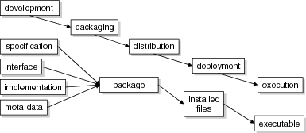
Component Development Stages
Across these stages, components are represented in different forms:
During development : UML etc.
When packaging : in a .zip file etc.
In the execution stage: blocks of code and data

Slide 91
Elements of a Component Model
Defines the types of building block, which can be composed with other components to create a software system
Interfaces : Defines how component can interact and also defines operation names, parameters and exceptions, which should be included in the interface definition
Usage : In order for components to be distributed and accessed remotely, they need to have a globally unique name or handle associated with them
Deployment : The component model includes a specification of how components should be packaged for deployment as independent, executable entities
Notes:
Specification describes properties to be realized: realization contract
Interface describes how components interact: usage contract
Different in scope as well: specification is about the component as a whole, while an interface might be about part of a component only
Interface defines how it needs to be defined ..that is operation names, parameters and exceptions in the interface definition
Metadata .. Since it can be accessed globally, a unique hierarchical name .. Provides an ability to discover the interfaces and attributes of the component for potential users
They have to be bundled together for independent executable entities .. Contents of package and its binary organization .. How components can be removed or replaced
1

Slide 92
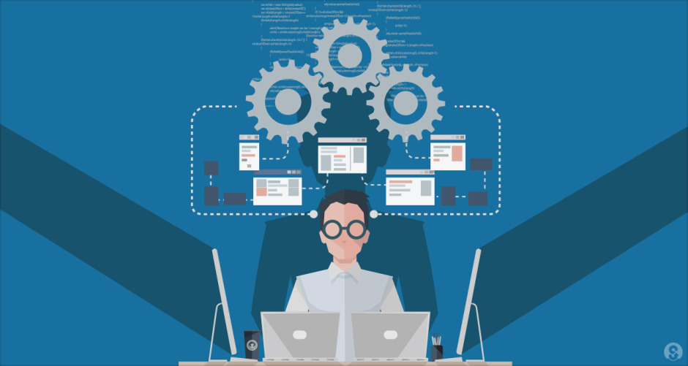
Service Oriented Architecture

Slide 93
Service Oriented Architecture
SOA is a software design methodology based on structured collections of discrete software modules, known as services, that collectively provide the complete functionality of a large or complex software application.
Its a logical representation of a repeatable business activity that has a specified outcome (e.g., check customer credit, provide weather data, consolidate drilling reports)
These could be implemented as discrete pieces of software or components written in any language capable of performing a task
These could be implemented as “callable entities” or application functionalities accessed via exchange of messages
These may also be application functionality with wrappers which can communicate through messages
Software is deployed “somewhere”, on-need basis .. SaaS

Slide 94
Service-oriented architecture (SOA)
A typical architecture contains an Orchestration/coordination layer, business service layer and infrastructure service layer or the service composition layer. There also exists a Service bus through which the communication takes place
Orchestration/coordination layer
service bus
physical
Discrete Software pieces Developed in any language
/Wrappers for legacy apps
logical
Business services layer
communication
service
- Contains services for Business logic
service
Infrastructure service layer
service
- Contains supporting activities storing Shipping of data
service

Slide 95
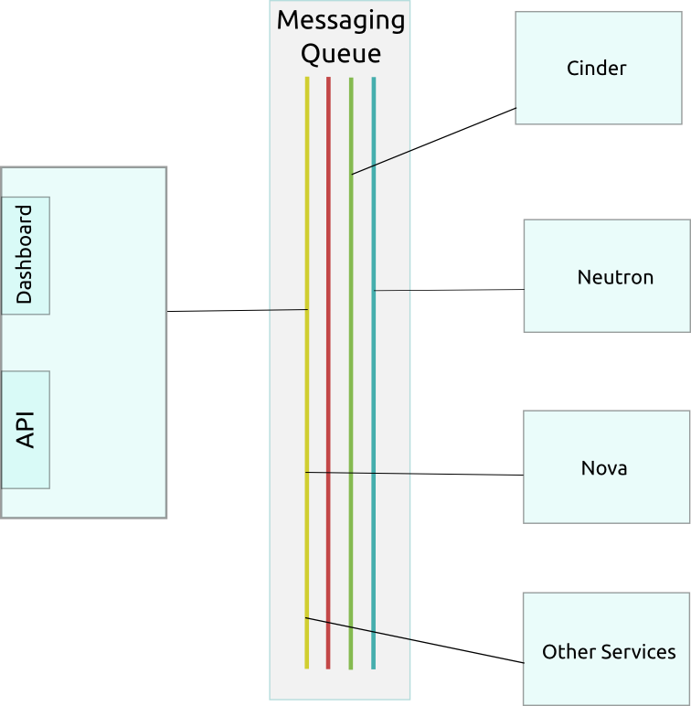
Example : Openstack

Slide 96
Product Lines

Slide 97
Motivation for Product Lines
Size & Complexity
Architecture
Quality
Product
Lines
Diversity
Reuse
Components
Lead Time
Reduction

Slide 98
Software Product Line Engineering
So Reuse is an imperative
Software product lines refers to engineering techniques for creating a portfolio of similar software systems from a shared set of software assets
A product line represents a family of manufactured products
A product line architecture explicitly captures the commonality and variability of a product line components and their compositions
Software Product Line Engineering makes it possible to
create software for different products
use variability to customize the software to each different product
Notes:
Product family :
Is a set of products with many commonalties and few differences.
Is intra-organizational.
Product Line:
Is a top-down, planned, proactive approach to achieve reuse of software within a family (or population, see the next section) of products.
1

Slide 99

Key Drivers for effective product lifecycle Re-Use :
Software product lines enhance reuse through predictive software reuse (rather than opportunistic)
Software artifacts are created when reuse is predicted in one or more products in a well defined product line
These artifacts could be built as components which are reusable or could be looked at as design patterns which could be built using some fine grained components for a particular solution

Slide 100
Product Line Engineering Framework
Product Management
Domain Engineering: Define and realize the commonality and variability
The goal is to establish a reusable platform
Domain Engineering
Product Management
Domain Requirements Engineering
Domain Design
Domain Realisation
Domain Testing
Application Engineering: Reuse domain artifacts, exploiting variability to build a product. The goal is to derive a product from the platform established in the Domain Engineering phase
Domain Artefacts incl. Variability Model
Requirements
Architecture
Components
Tests
Application Engineering
Application Requirements Engineering
Application Design
Application Realisation
Application Testing
Application N – Artefacts incl. Variability Model
Application 1 – Artefacts incl. Variability Model
Requirements
Architecture
Components
Tests
Based on the “Software Product Line Engineering” book by Klaus Pohl, Günter Böckle and Frank J. van der Linden
* All credits go to an IBM presentation on the Internet from where this has been leveraged

Slide 102
REQUIREMENTS ENGINEERING

Slide 103
Software Requirements & Requirement properties

Slide 104

Generics
Is usually the first step in any software intensive development lifecycle irrespective of model
Usually difficult, error prone and costly
Critical for successful development of all down stream activities
Errors introduced during requirements phase if not handled properly will propagate into the subsequent phases
Unnecessary, Late or invalid requirements can make the system cumbersome or slip
Requirement errors are expensive to fix
V3.0 © 2011, IEEE All rights reserved

Slide 105
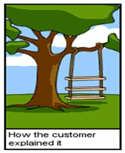
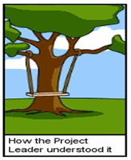
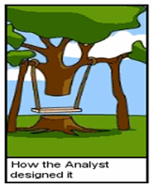
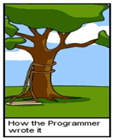
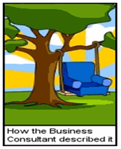





Cartoon on the Software Development
Notes:
1

Slide 106

Cost of repair as a function of time
V3.0 © 2011, IEEE All rights reserved

Slide 107

Definition of Requirement
Requirement is the Property which must be exhibited by software developed/adapted to solve a particular problem
Requirement should specify the externally visible behavior of what and not how
Requirements can be looked at as
Individual requirements
Set of requirements
V3.0 © 2011, IEEE All rights reserved

Slide 108
Properties of Requirement
Clear - Requirements should be written in precise, simple language that every reader can understand
Consistent - No requirement should contradict another
Clear
Feasible – realizable with a specified time frame
Quantifiable
Concise
Unambiguous - A requirement should have only one interpretation
Prioritized
Consistent
Traceable – backwards to stakeholder request and forward to software components
Individual Requirements
Concise – Requirements should describe a single property and expressed with as few words as possible
Verifiable
Unambiguous
Verifiable - requirement must have a clear, testable criterion and a cost-effective process to check it has been realized as requested
Traceable
Feasible
Quantifiable - the requirement should be quantifiable, which aids in testing and verifying
Prioritized - requirements should be prioritized
Use Active Present Tense
Use Terminology Consistently
Avoid combining Requirements
V3.0 © 2011, IEEE All rights reserved

Slide 109
Examples
All screens must appear on the monitor quickly
or
When the user accesses any screen, it must appear on the monitor within 2 seconds (Clear – Concise - Unambiguous – Verifiable - Measurable)
The replacement control system shall be installed with no disruption to production
or
The replacement control system shall be installed causing no more than 2 days of production disruption
(Feasible)

Slide 110
Examples
The system must generate a batch end report and a discrepancy report when a batch is aborted
or
The system must generate a batch end report when a batch is completed or aborted
The system must generate a discrepancy report when a batch is aborted.
(Traceable)
The system must be user friendly
or
The user interface shall be menu driven. It shall provide dialog boxes, help screens, radio buttons, dropdown list boxes, and spin buttons for user inputs
(Verifiable)

Slide 111
Properties of a set of Requirement
The goals that are represented by the requirements should be attainable within the time, resource, and cost constraints placed upon the project.
When there are many requirements but limited time or budget, choices must be made about what to include or exclude. Factors such as changes in customer needs, improved developer understanding of the products, and changes in organizational policy will affect the stability of requirements.
Realistic
Ranked for Importance or Stability
Complete
Sets of Requirements
All the services that are needed from the system should be included
Changes to the requirements should be able to be made easily, completely, and consistently while retaining the structure and style.
Modifiable
Correct
Every requirement should be one that the software will meet
V3.0 © 2011, IEEE All rights reserved
Notes:
1

Slide 112
Feasibility Study

Slide 113
Feasibility Study
Mostly done before beginning a project, a short, low-cost study to identify.
Project Identification
Feasibility
Study
REQUIREMENTS
ENGINEERING
Feasibility
Report
Approval

Slide 114
Activities in Feasibility Study
Client or the sponsor or the User who would have a stake in the project
What is the current solution to the problem
Who are the targeted customers and what is the future market place
Potential benefits : What would be gained by doing this project
Scope : A high level “what is included and what is not included” (This mostly includes High-level abstract description of the requirements)

Slide 115
Activities in Feasibility Study
High level block Level understanding of the solution
Considerations to technology
Marketing strategy
Financial projection
Schedule and high level planning and budget requirements
Issues, Assumptions, Risks and Constraints
Alternatives and their consideration
Potential project organization
Will end with a go or No-go Decisions

Slide 116
Requirements Engineering Process

Slide 117
Requirements Engineering process
There are “four + one” sets of activities that have been used, and have shown to produce specifications or requirements
Iterative Process
Requirements Elicitation
Requirements Analysis
Requirements Specification
Requirements Validation
Requirements Management
STEP 1
STEP 2
STEP 3
STEP 4
Requirements specification – process of creating of software and system specification documents suitable for use in further designing the software and in maintaining it
Requirements elicitation - process of gathering and discovering requirements
Requirements analysis - process of reviewing the requirements - which classifies the requirements, models the requirements, allocates them to a architectural design of the software and performs any tradeoffs and negotiations between the stakeholders
Requirements validation - help ensure that the right requirements are realized
- process of set of formal and informal reviews that will help ensure that the requirements when realized will meet the customer’s needs under the specified operating environment
- also uses modeling, prototypes and ultimately acceptance testing of the final product to verify and validate the correctness of the requirements
The project manager plans and drives this entire activity
V3.0 © 2011, IEEE All rights reserved
1

Slide 119
REQUIREMENTS ENGINEERING

Slide 120
Requirements Elicitation

Slide 121

Requirements Elicitation process
Is a process of working proactively with all stakeholders gathering their needs, articulating their problem, identify and negotiate potential conflicts thereby establishing a clear scope and boundary for a project
It can also be described as a process of ensuring that the stakeholders have been identified and they have been given an opportunity to explain their problem and needs and describe what they would like the new system to do
V3.0 © 2011, IEEE All rights reserved
1

Slide 122
Requirements Elicitation process
Involves
Understanding the problem
Understanding the domain
Identifying clear objectives
Understanding the needs
Understanding constraints of the system stake holders
Writing business objectives for the project
V3.0 © 2011, IEEE All rights reserved
1

Slide 123
Requirements Elicitation process
Elicitation Techniques
The approach depends on
Nature of the system being developed
For example a UI intensive system needs a different approach compared to an embedded system as the navigation and behaviour is visible, so easy to comprehend
Background and experience of stakeholders
If the stakeholder is a very hands-on person then prototyping and simulation would work
For non-computer savvy persons documents would be necessary
1

Slide 124
Requirements Elicitation process
Elicitation Techniques Active - where there are ongoing interaction between the stake holders and users. Some of the techniques are interviews facilitated meetings role-playing Prototypes Ethnography (study/collect the system in its normal working surroundings) Scenarios | Passive - infrequent interaction between the stake holders and users. E.g. use of use cases business process analysis and modelling workflows questionnaires checklists documentation
1

Slide 125
Requirements Analysis

Slide 126


Iterative Process
Requirements Elicitation
Requirements Analysis
Requirements Specification
Requirements Validation
Requirements Management
Requirements Analysis process
V3.0 © 2011, IEEE All rights reserved

Slide 127
Iterative Process
Requirements Elicitation
Requirements Analysis
Requirements Specification
Requirements Validation
Requirements Management
Requirements Analysis process
Understand the requirements in depth, both from a product and process perspective
Classify and Organize the requirements into coherent clusters
Functional, Non-Functional & Domain requirements
System and User Requirements
Model the requirements
Analyze the requirements (if necessary) using fish bone diagram
1

Slide 128
Iterative Process
Requirements Elicitation
Requirements Analysis
Requirements Specification
Requirements Validation
Requirements Management
Requirements Analysis process
Recognize and resolve conflicts (e.g., functionality v. cost v. timeliness)
Negotiate Requirements
Prioritize the requirements (MoSCoW -Must have, Should have, Could have, Wont have)
Identify risks if any
Decide on Build or Buy (Commercial Of The Shelf Solution) and refine requirements
1

Slide 129



Iterative Process
Requirements Elicitation
Requirements Analysis
Requirements Specification
Requirements Validation
Requirements Management
Requirements Analysis process
Understand the requirements in depth, both from a product and process perspective
Requirement or Problem needs to be correctly internalized
Understand the requirements in depth, both from a product and process perspective
Classify and Organize the requirements into coherent clusters
Model the requirements
Analyze the requirements (if necessary) using fish bone diagram
Recognize and resolve conflicts (e.g., functionality v. cost v. timeliness)
Negotiate Requirements
Prioritize the requirements (MoSCoW -Must have, Should have, Could have, Wont have)
Identify risks if any
Decide on Build or Buy (Commercial Of The Shelf Solution) and refine requirements
Could be a problem to a game
A Storm coming in
Could be a blessing to a farmer

Slide 130
Iterative Process
Requirements Elicitation
Requirements Analysis
Requirements Specification
Requirements Validation
Requirements Management
Requirements Analysis process
Classify and Organize the requirements into coherent clusters
Functional, Non-Functional & Domain requirements
Understand the requirements in depth, both from a product and process perspective
Classify and Organize the requirements into coherent clusters
Model the requirements
Analyze the requirements (if necessary) using fish bone diagram
Recognize and resolve conflicts (e.g., functionality v. cost v. timeliness)
Negotiate Requirements
Prioritize the requirements (MoSCoW -Must have, Should have, Could have, Wont have)
Identify risks if any
Decide on Build or Buy (Commercial Of The Shelf Solution) and refine requirements
Functional Requirements Functionality or services, the system should provide with different inputs, and expression on how the system should behave in particular situations Could be written as high-level statements Can be verified This also indicates states what the system should not do Example : System shall assign a unique tracking number to each shipment | Non-Functional Requirements Constraints on the services or functions offered by the system such as timing constraints, constraints on the development process, standards etc. Often applied to the system as a whole rather than individual features or services. Specify the criteria that can be used to judge the operation of the system Example: With 100 concurrent users a database record shall be fetched over the network in less than 3ms
Domain requirements Constraints on the system from the domain of operation

Slide 131
Iterative Process
Requirements Elicitation
Requirements Analysis
Requirements Specification
Requirements Validation
Requirements Management
Requirements Analysis process
Classify and Organize the requirements into coherent clusters (Cont.)
System and User requirements
Understand the requirements in depth, both from a product and process perspective
Classify and Organize the requirements into coherent clusters
Model the requirements
Analyze the requirements (if necessary) using fish bone diagram
Recognize and resolve conflicts (e.g., functionality v. cost v. timeliness)
Negotiate Requirements
Prioritize the requirements (MoSCoW -Must have, Should have, Could have, Wont have)
Identify risks if any
Decide on Build or Buy (Commercial Of The Shelf Solution) and refine requirements
User Requirements Statements in natural language plus informal context diagrams system/sub-system and their interconnections and operational constraints. Written for/by customers. | System Requirements A structured document setting out detailed descriptions of the system’s functions, services and operational constraints. Defines what should be implemented so may be part of a contract between client and contractor. Also called Software requirements / Functional specifications

Slide 132
Iterative Process
Requirements Elicitation
Requirements Analysis
Requirements Specification
Requirements Validation
Requirements Management
Requirements Analysis process
Model the requirements
A Model is a representation of a system in some form. A is a Model of B if A can be used to answer questions about B
Understand the requirements in depth, both from a product and process perspective
Classify and Organize the requirements into coherent clusters
Model the requirements
Analyze the requirements (if necessary) using fish bone diagram
Recognize and resolve conflicts (e.g., functionality v. cost v. timeliness)
Negotiate Requirements
Prioritize the requirements (MoSCoW -Must have, Should have, Could have, Wont have)
Identify risks if any
Decide on Build or Buy (Commercial Of The Shelf Solution) and refine requirements
How would you represent a
Briefcase
Online Shopping
Briefcase
Model of a Briefcase
Briefcase
Capacity Weight
+ Open() + Close()
Other Examples of Models
Building Plan

Slide 133
Iterative Process
Requirements Elicitation
Requirements Analysis
Requirements Specification
Requirements Validation
Requirements Management
Requirements Analysis process
Modelling Systems (Cont.)
Goals for the models (or why models)
Understanding (existing) System
Analyzing and Validating the requirements in terms of visible requirements within the problem
Make modifications
Fix, Upgrade, Integrate
Communicating the requirements in terms of who, what and interpreting it in the same way
Should typically provide value to all stakeholders
Should help predict system behavior
“What if” analysis (financial models)
Test system
Performing tests when doing so on real systems are risky and expensive
Example: Test limits or breaking point
Should be Simple

Slide 134
Iterative Process
Requirements Elicitation
Requirements Analysis
Requirements Specification
Requirements Validation
Requirements Management
Requirements Analysis process
Modelling Systems (Cont.)
Structure Models
Captures static aspects of system
What entities exist in the system?
How are they related?
Example: Organization Chart
Behaviour Models
Captures dynamic aspects of the system
How do the entities interact in response to a stimulus?
Example: Process
PROBLEM
Solution
Analysis Model
Analysis Model
Problem Space Solution Space
Models could Informal e.g. Prose or could Simple Procedural e.g. Flowcharts or Pseudo Code or could be formal static models like ER diagrams or dynamic models.

Slide 135
Iterative Process
Requirements Elicitation
Requirements Analysis
Requirements Specification
Requirements Validation
Requirements Management
Requirements Analysis process
Modelling Systems (Cont.)
Some Simple Models
Browser
Web Server
HTTP Response
HTTP is an Application Layer Protocol (Defined in RFC 2616 of IETF)
Specifies what messages are exchanged between Client and Server (but not how they are transported)
Web Server
API
Applications, Databases
TCP
They could be UML based models like Use Case models (we will discuss this in more detail next class)

Slide 136
Iterative Process
Requirements Elicitation
Requirements Analysis
Requirements Specification
Requirements Validation
Requirements Management
Requirements Analysis process
Model the requirements (Cont.)
Models could Informal e.g. Prose or could Simple Procedural e.g. Flowcharts or Pseudo Code or could be formal static models like ER diagrams or dynamic models.
They could be UML based models like Use Case models (we will discuss this in more detail next class)
PROBLEM
A logical first step in creating a model is to identify the essential components of the system being modeled and further break it down - typically called as decomposition
Solution
Goals for the models
Analyzing and Validating the requirements in terms of visible requirements within the problem
Communicating the requirements in terms of who, what and interpreting it in the same way
Should provide value to all stakeholders
Should be Simple
Analysis Model
Analysis Model
Advantages of Modelling
Ability to make changes with minimal costs
Models help in visualizing the solution
Problem Space Solution Space

Slide 137
Iterative Process
Requirements Elicitation
Requirements Analysis
Requirements Specification
Requirements Validation
Requirements Management
Requirements Analysis process
Model the requirements
A logical first step in creating a model is to identify the essential components of the system being modeled typically called as decomposition
Goals for the models
Analyzing and Validating the requirements in terms of visible requirements within the problem
Communicating the requirements in terms of who, what and interpreting it in the same way
Should provide value to all stakeholders
Should be Simple
Models could Informal e.g. Prose or could Simple Procedural e.g. Flowcharts or Pseudo Code or could be formal static models like ER diagrams or dynamic models.
They could be UML based models like Use Case models (we will discuss this in more detail next class)
Understand the requirements in depth, both from a product and process perspective
Classify and Organize the requirements into coherent clusters
Model the requirements
Analyze the requirements (if necessary) using fish bone diagram
Recognize and resolve conflicts (e.g., functionality v. cost v. timeliness)
Negotiate Requirements
Prioritize the requirements (MoSCoW -Must have, Should have, Could have, Wont have)
Identify risks if any
Decide on Build or Buy (Commercial Of The Shelf Solution) and refine requirements

Slide 138

Iterative Process
Requirements Elicitation
Requirements Analysis
Requirements Specification
Requirements Validation
Requirements Management
Requirements Analysis process
Analyze the requirements using fish bone diagram
List out all the reasons/causes on why the requirement (effect) has come in and become relevant
Understand the requirements in depth, both from a product and process perspective
Classify and Organize the requirements into coherent clusters
Model the requirements
Analyze the requirements (if necessary) using fish bone diagram
Recognize and resolve conflicts (e.g., functionality v. cost v. timeliness)
Negotiate Requirements
Prioritize the requirements (MoSCoW -Must have, Should have, Could have, Wont have)
Identify risks if any
Decide on Build or Buy (Commercial Of The Shelf Solution) and refine requirements

Slide 139
Iterative Process
Requirements Elicitation
Requirements Analysis
Requirements Specification
Requirements Validation
Requirements Management
Requirements Analysis process
Recognize and Resolve Conflicts
Functionality Vs Cost Vs timelines
Negotiate requirements
Prioritize the requirements (MoSCoW -Must have, Should have, Could have, Won’t have)
Pareto Analysis (80-20 to focus on vital few to trivial many)
Identify risks if any
Decide on Build or Buy (Commercial Of The Shelf Solution- COTS) and refine requirements

Slide 141
REQUIREMENTS ENGINEERING

Slide 142
Modelling – UML and Use Case Models

Slide 143
Modelling Recap
A Model is a representation of a system in some form. A is a Model of B if A can be used to answer questions about B
Couple of important goals of Modelling
Providing an Understanding (existing) System
Analyzing and Validating the requirements in terms of visible requirements within the problem
Communicating the requirements in terms of who, what and interpreting it in the same way
Discussed different kinds of Models
Structural Models and Behavioral models
Notes:
Take example of electrical circuits

Slide 144
What is UML
Unified Modeling Language
Language to express different types of models
Language defines
Syntax – Symbols and rules for using them
Semantics – What these symbols represent
UML can be used to
Visualize (Graphical Notation)
Specify (Complete and Unambiguous)
Construct (Code Generation)
Document (Design, Architecture, etc.)
the artifacts of software-intensive systems
Notes:
Take example of electrical circuits

Slide 145

Conceptual model of UML
Diagrams : Graphical representation of set of elements, often rendered as a set of connected graph of vertices (things) and arcs (relationships)
It’s a projection into the system
Relationship ties together the things or abstractions
There are four different kinds of relationships
Things are abstractions in the model.
There are four kinds of things or abstraction
UML
Use case is a description of set of sequences of actions that a system performs that yields an observable result of value to a particular actor in other words a functional requirement
Its used to structure the behavior. Its
realized using collaboration. Depicted as an ellipse with solid lines
Building
blocks
Rules
Common
mechanisms
name, scope, visibility
Diagrams
UML is made up of three conceptual elements. They are
Building blocks which make up the UML
Rules that dictate how these building blocks can be put together
Common mechanisms that apply through out UML
Things
Relations
Class
Object
Use case
Sequence
Collaboration
Statechart
Activity
Component
Deployment
Dependency
Association
Generalization
Realization
Structural
Behavioral
Grouping
Annotate
Class
Interface
Active class
Component
Node
Interaction
State machine
Package
Note
Use Case Diagram
Shows actors, use cases, and relationships
Use case
Collaboration
1
Notes:
Things are abstractions in the model
Relations deal with how these abstractions tie together
Group interesting collections of things
1

Slide 146
Conceptual model of UML
Diagrams
Graphical representation of set of elements, often rendered as a set of connected graph of vertices (things) and arcs (relationships)
It’s a projection into the system
Component Diagram
Shows deployable components, including interfaces, ports, and internal structure
State Diagram
Shows states, transitions, events, and activities depicting the dynamic view of internal object states
Activity Diagram
Shows processes, including flow of control and data
UML
Class Diagram
Shows classes, interfaces, relationships
Most common – address static view
Object Diagram
Shows objects (instances)
Use Case Diagram
Shows actors, use cases, and relationships
Collaboration Diagram
Interaction diagram similar to sequence diagram, but a spatial view, using numbering to indicate time order
Sequence Diagram
Shows interactions between objects as a time-ordered view
Deployment Diagram
Shows the configuration of run-time processing nodes and the components that are deployed on them
Building
blocks
Rules
Common
mechanisms
name, scope, visibility
Things
Relations
Diagrams
Class
Object
Use case
Sequence
Collaboration
Statechart
Activity
Component
Deployment
Dependency
Association
Generalization
Realization
Structural
Behavioral
Grouping
Annotate
Class
Interface
Active class
Component
Node
Interaction
State machine
Package
Note
Use case
Collaboration
1
Notes:
Things are abstractions in the model
Relations deal with how these abstractions tie together
Group interesting collections of things
1

Slide 147

UML Diagrams
Structural things are the nouns of the UML models. Represent elements that are either conceptual or physical
These are dynamic parts of the UML models. Represent behavior over time and space. Typically verbs of the model

Slide 148
UML Models and associated diagram types
Static or Structural diagrams:
What must be in the system
Class
Component
Deployment
Composite structure
Object
Package
Dynamic or Behavioral diagrams:
What must happen in the system
Activity
State machine
Use case
Interaction diagram (kind of Dynamic diagram):
[emphasize the flow of control and data among the things in the system]
Communication
Sequence
Timing
1

Slide 149
Conceptual model of UML (repeat .. for readability purpose)
UML
Building
blocks
Rules
Common
mechanisms
name, scope, visibility
Things
Relations
Diagrams
Class
Object
Use case
Sequence
Collaboration
Statechart
Activity
Component
Deployment
Dependency
Association
Generalization
Realization
Structural
Behavioral
Grouping
Annotate
Class
Interface
Active class
Component
Node
Interaction
State machine
Package
Note
Use case
Collaboration
1
Notes:
Things are abstractions in the model
Relations deal with how these abstractions tie together
Group interesting collections of things
1

Slide 150
UML Diagrams (repeat contents for the Animated Slide)
Use Case Diagram
Shows actors, use cases, and relationships
Class Diagram
Shows classes, interfaces, relationships
Most common – address static view
Object Diagram
Shows objects (instances)
Component Diagram
Shows deployable components, including interfaces, ports, and internal structure
Activity Diagram
Shows processes, including flow of control and data

Slide 151
UML Diagrams… (continued) repeated contents for the Animated Slide
State Diagram
Shows states, transitions, events, and activities depicting the dynamic view of internal object states
Sequence Diagram
Shows interactions between objects as a time-ordered view
Collaboration Diagram
Similar to sequence diagram, but a spatial view, using numbering to indicate time order
Deployment Diagram
Shows the configuration of run-time processing nodes and the components that are deployed on them

Slide 152
Using Use Case Diagrams
Use case diagrams are used to visualize, specify, construct, and document the (intended) behavior of the system, during requirements capture and analysis.
Provide a way for developers, domain experts and end-users to Communicate.
Serve as basis for testing.
Use case diagrams contain use cases, actors, and their relationships.

Slide 153
Use Case
Use cases specify the desired behavior.
A use case is
a description of a set of sequences of actions a system performs to yield an observable result of value to an actor.
includes variants
Named as verb.
Each sequence represent an interaction of actors with the system.
name

Slide 154
Actors
An actor represents a set of roles that users of use case play when interacting with these use cases.
Actors can be human or automated systems.
Actor is someone interacting with use case (system function). Named by noun.
Actors are entities which require help from the system to perform their task or are needed to execute the system’s functions.
Actors are not part of the system.
An Actor triggers use case
Actor has responsibility toward the system (inputs), and have expectations from the system (outputs).
name
<< actor >>
X Authorization System

Slide 155

Example of Use Case Diagram

Slide 156
Example
registration
updating
grades
student
faculty
output
generating

Slide 157
Relationships between Use Cases
1. Generalization - use cases that are specialized versions of other use cases.
2. Include - use cases that are included as parts of other use cases. Enable to factor common behavior.
3. Extend - use cases that extend the behavior of other core use cases. Enable to factor variants.

Slide 158
1. Generalization
The child use case inherits the behavior and meaning of the
parent use case.
The child may add to or override the behavior of its parent.
Share the same relationship to the actor
parent
child

Slide 159
More about Generalization
registration
non-graduate
registration
graduate
registration

Slide 160
Generalization as a Relationships between Actors
student
graduate
student
non-graduate
student

Slide 161
2. Include
The base use case explicitly incorporates the behavior of another use case at a location specified in the base.
The included use case never stands alone. It only occurs as a part of some larger base that includes it.
<<include>>
base
included

Slide 162
More about Include
Enables to avoid describing the same flow of events several times by putting the common behavior in a use case of its own.
Process Sale request
Process rental request
<<include>>
<<include>>
Handle Credit Card Payment

Slide 163
3. Extend
The base use case implicitly incorporates the behavior of another use case at certain points called extension points.
The base use case may stand alone, but under certain conditions its behavior may be extended by the behavior of another use case.
base
<<extend>>
extending

Slide 164
More about Extend
Enables to model optional behavior or branching under conditions.
<<extend>>
Exam-grade appeal
Exam copy request
1

Slide 165
Relationships between Use Cases and Actors
Actors may be connected to use cases by associations, indicating that the actor and the use case communicate with one another using messages.
updating
grades
faculty

Slide 166
Example
place
conference call
place
phone call
<<extend>>
cellular
network
receive
additional call
receive
phone call
<<extend>>
use
scheduler
user
Cellular Telephone

Slide 167
Use case diagram of a restaurant
Use Case

Slide 168
Formal template for representing of a Use Case – Use case Specification
Name (Must start with a verb)
Summary
Actors
Pre-conditions
Conditions that must exist before the use case is executed
Description
Textual description (may include steps to execute) and typically is the primary functionality
Exceptions
These are paths which will need to handle exceptions which could be all to provide handling of things which are not provide you with a primary functionality including things like power failure
Alternate Flows
Handles the other functionality paths for the summary these could be some in the exceptions too
Post-conditions
Conditions that must exist after the use case is executed
Notes:
It is important to add details for an use case as graphical representation is not enough.
1

Slide 169
Example (Internet Banking)
Name: Transfer Funds
Summary/Overview : Transfer funds from one account to another
Actor: Customer
Pre-conditions
Source account must have sufficient funds
Description
Customer identifies the accounts from which and to which funds have to be transferred, enters the amount to be transferred, and confirms the transaction
Exceptions
Cancel, Insufficient funds, Cannot identify destination account
Needs to handle ..say power failure
Alternate Flows
Handles all the exception paths
Post-conditions
Funds transferred and account balances updated

Slide 170


Slide 171


Slide 172
How to create Use Case diagram
List main system functions (use cases) in a column
Draw ovals around the function labels
Draw system boundary
Draw actors and connect them with use cases
Specify include and extend relationships between use cases

Slide 173
Each use case may include all or part of the following:
Title or Reference Name - meaningful name of the UC
Author/Date - the author of the UC and its creation date
Modification/Date - last modification to the UC and its date
Purpose - specifies the goal to be achieved by the UC
Overview - short description of the use cases processes
Cross References - requirements references
Actors - agents which initiate or participate in the UC
Pre Conditions - must be true to allow the execution of the UC
Post Conditions - will be set when the use use completes its execution normally
Normal flow of events - regular flow of activities of the UC
Alternative flow of events - other flow of activities of the UC
Exceptional flow of events - unusual situations
Implementation issues - possible foreseen problems in the implementation of the UC
Use Case Description
Each use case may include all or part of the following:
Title or Reference Name - meaningful name of the UC
Author/Date - the author and creation date
Modification/Date - last modification and its date
Purpose - specifies the goal to be achieved
Overview - short description of the processes
Cross References - requirements references
Actors - agents participating
Pre Conditions - must be true to allow execution
Post Conditions - will be set when completes normally
Normal flow of events - regular flow of activities
Alternative flow of events - other flow of activities
Exceptional flow of events - unusual situations
Implementation issues - foreseen implementation problems

Slide 174
Example- Money Withdraw
Actors: Customer
Pre Condition:
The ATM must be in a state ready to accept transactions
The ATM must have at least some cash on hand that it can dispense
The ATM must have enough paper to print a receipt for at least one transaction
Post Condition:
The current amount of cash in the user account is the amount before the withdraw minus the withdraw amount
A receipt was printed on the withdraw amount
The withdraw transaction was audit in the System log file

Slide 175
Example- Money Withdraw (cont.)
Typical Course of events:
Actor Actions | System Actions
1. Begins when a Customer arrives at ATM
2. Customer inserts a Credit card into ATM | 3. System verifies the customer ID and status
5. Customer chooses “Withdraw” operation | 4. System asks for an operation type
7. Customer enters the cash amount | 6. System asks for the withdraw amount
 | 8. System checks if withdraw amount is legal
 | 9. System dispenses the cash
 | 10. System deduces the withdraw amount from account
 | 11. System prints a receipt
13. Customer takes the cash and the receipt | 12. System ejects the cash card

Slide 176
Example- Money Withdraw (cont.)
Alternative flow of events:
Step 3: Customer authorization failed. Display an error message, cancel the transaction and eject the card.
Step 8: Customer has insufficient funds in its account. Display an error message, and go to step 6.
Step 8: Customer exceeds its legal amount. Display an error message, and go to step 6.
Exceptional flow of events:
Power failure in the process of the transaction before step 9, cancel the transaction and eject the card

Slide 177
Example- Money Withdraw (cont.)
One method to identify use cases is actor-based:
Identify the actors related to a system or organization.
For each actor, identify the processes they initiate or participate in.
A second method to identify use cases is event-based:
Identify the external events that a system must respond to.
Relate the events to actors and use cases.
The following questions may be used to help identify the use cases for a system:
What are tasks of each actor ?
Will any actor create, store, change, remove, or read information in the system ?
What use cases will create, store, change, remove, or read this information ?
Will any actor need to inform the system about sudden, external changes ?
Does any actor need to be informed about certain occurrences in the system ?
Can all functional requirements be performed by the use cases ?

Slide 179
REQUIREMENTS ENGINEERING

Slide 180
Requirements Specification

Slide 181

Requirements Specification
Once requirements are elicited .. analyzed .. we then specify those requirements..
Requirements specification is the documentation of a set of requirements that is reviewed and approved by the customer and provides direction for the software construction activities in the next stage of the life cycle
The software requirements specification (SRS) document is the basis for customers and contractors/suppliers agreeing on what the product will and will not do. It describes both the functional and nonfunctional requirements

Slide 182
Documentation Characteristics
Reasons for documentation:
Visibility (e.g. needed for project plan)
Formalization leads to better clarity when expressed in writing
User support (e.g., user manual)
Team communication (e.g. interface specifications, global teams)
Maintenance and evolution (e.g., requirements and easier control)
Characteristics of documentation:
Accurate and kept current
Appropriate for audience
Maintained online (usually)
Simple but professional in style and appearance

Slide 183
Requirements Specification
Non
Functionality

Slide 184
Software Requirements Specification (SRS)
Functionality: What is the software supposed to do? External interfaces. How does the software interact with people, the system’s hardware, other hardware, and other software? Non Functionality. This includes all of the Quality criteria's which drive the functionality. These could be Performance - What is the speed, response time, recovery time, etc., of various software functions? Other Quality Attributes like Availability, Portability, correctness, maintainability, etc. | Design constraints imposed on an implementation required standards in effect implementation language policies for database integrity resource limits security operating environment(s) etc.?

Slide 185
Software Requirements Specification (SRS)
ToC recommended by IEEE for SRS (IEEE Std. 830-1998) 1. Introduction 1.1 Purpose 1.2 Scope 1.3 Definitions, acronyms, and abbreviations 1.4 References 1.5 Overview 2. Overall description 2.1 Product perspective 2.2 Product functions 2.3 User characteristics | 2.4 Constraints 2.5 Assumptions and dependencies 3. Specific requirements 3.1 External Interface 3.2 Functional Requirements 3.3 Non-Functional Requirements 3.4 Design Constraints Appendixes Index
Illustration

Slide 186
Iterative Process
Requirements Elicitation
Requirements Analysis
Requirements Specification
Requirements Validation
Requirements Management
Requirements Validation
The purpose of requirements is to help ensure that the requirements does what the customer wants
This is an important phase because repairing requirement errors in downstream phases can be expensive
Validation and Verification
Validation determines whether the software requirements if implemented, will solve the right problem and satisfy the intended user needs
Verification determines whether the requirements have been specified correctly
(Reviews are used for both validation and verification)

Slide 187

Iterative Process
Requirements Elicitation
Requirements Analysis
Requirements Specification
Requirements Validation
Requirements Management
Requirements Validation
Requirement Reviews

Slide 188
Iterative Process
Requirements Elicitation
Requirements Analysis
Requirements Specification
Requirements Validation
Requirements Management
Requirements Validation
Prototyping
Prototype facilitates user involvement during requirements engineering phase and ensures engineers and users have the same interpretation of the requirements
Prototyping is most beneficial in systems
that will have many user interactions
Example - design of online billing systems where the use of screen dialogs is extensive
Systems with little or no user interaction may not benefit as much from prototyping
such as batch processing or systems that mostly do calculations

Slide 189
Iterative Process
Requirements Elicitation
Requirements Analysis
Requirements Specification
Requirements Validation
Requirements Management
Requirements Validation
Model Validation
Ensuring that the models represent all essential functional requirements These could be Use Case or other models
Demonstrating that each model is consistent in itself
Example : Flow diagrams, class models and static analysis, verify for existence of proper communication paths to facilitate data exchange
Usage of the Fish Bone Analysis technique to validate if the requirements identified is addressing the reasons needing the solution to the problem which had led to the requirements
Acceptance Criteria
Using Acceptance criteria’s to see if there are requirements matching with that the Acceptance criteria

Slide 190
Iterative Process
Requirements Elicitation
Requirements Analysis
Requirements Specification
Requirements Validation
Requirements Management
Requirements Management
Requirements specification is the baseline on which the future lifecycle phases will need to build upon
Requirements can change due to
Better understanding of the problem
Customer internalizing the problem and solution
Evolving environment and technology landscape
Requirements management has two facets
Ensuring that the requirements are all addressed in each phases of the lifecycle
Ensuring that the changes in the requirements are handled appropriately

Slide 191

Requirements Traceability Matrix - RTM
Req Id | Architectural Section | Design Section | File/ Implementation | Unit Test Id | Functional Test ID | System Test ID | Acceptance Test Id
Requirements identification – This could be a number like FR-1/NF-1 or a unique use case reference UC-1, goal-hierarchy numbering along with version information etc.)
Every phase of the SDLC progressively fills the RTM
Requirements are traced across the SDLC using the requirement traceability matrix (RTM)
Forward Tracing
Backward Tracing

Slide 192
Iterative Process
Requirements Elicitation
Requirements Analysis
Requirements Specification
Requirements Validation
Requirements Management
Requirements Change Management
Reiterating, number of things can change in the environment during the development … leading to change in Requirements
Change in the requirements have impacts on plans, work products etc.
Uncontrolled changes can have a huge adverse impact on project in terms of cost, schedule, quality and expectations
Changes have to be allowed, but in a controlled manner or in other words has to be managed
In the perspective of managing the changes, change requests go through a formal change management process as in the subsequent slides

Slide 193
Iterative Process
Requirements Elicitation
Requirements Analysis
Requirements Specification
Requirements Validation
Requirements Management
Requirements Change Process
Log the request for change and assign a change request Identifier Log Who is requesting for the change Why is the request coming in What is being requested to change Perform impact analysis on the work products and items Estimate impact on scope, effort and schedule (may be quality) Review impact with stakeholders | Solicit Formal Approval as part of the approval process Rework the work products/items Log the following post changes When was it changed Who all made changes Who reviewed the changes Who tested the changes Which release stream is the change going to be part of

Slide 194

Iterative Process
Requirements Elicitation
Requirements Analysis
Requirements Specification
Requirements Validation
Requirements Management
Requirements Change Management
Change Control
Traceability
Version Control
Status Tracking
Impact of change at specific phases
Links between user requirement, architecture design, implementation, testing of all system components
Record approved changes
Pending
Approved
Rejected
Communicate changes
Deferred
Responding to change requests
Validated
New document versions
Completed
Cancelled

Slide 196
SOFTWARE PROJECT MANAGEMENT

Slide 197

Software Project Management Fundamentals

Slide 198
Software Project Management Fundamentals
Software Engineering is very relevant for large projects
These large projects could involve several people (10s to 100s to 1000s) working together for a prolonged length of time (several months to years)
These projects need to be planned (which is significant % of the management activity) and controlled
This needs co-ordination for ensuring Integration/ interoperability/ & working together

Slide 199
Software Projects and their characteristics
Software projects are temporary individual or collaborative enterprises that are carefully planned to achieve a particular aim/or to create a unique product or service. These projects typically have certain characteristics
They are made up of certain unique activities which do not repeat under similar circumstances
They are goal specific
Typically contain a sequence of activities to deliver the end product
Time bound- Every project has a specified start and end date
Technically inter-related activities

Slide 200
Software Project Management Fundamentals
Projects are constrained by Scope, Time (Schedule), Cost (of all Resources)
Project Management will need to maintain this triangle in Equilibrium
Cost
Scope
Quality of Project
Time

Slide 201
Software Project Management Lifecycle
Project Management Life Cycle
Initiation and Approval
Monitoring Execution and Control
Planning
Closing
Step 2
Step 4
Step 1
Step 2
Step 3
System/Software Development Life Cycle
Implementation
Testing
Requirements Eng.
Design
Architecture
Deploy

Slide 202


Project planning process
More details towards planning will be discussed in the next session

Slide 203

Software Project Monitoring and Control
Project Monitoring and control of the project begins once the project plan is created.
The Monitoring and Controlling process is continuously performed and encompasses all the tasks and uses all the measures and metrics necessary to ensure that the project is on track e.g. within scope, on-time, within budget and proceeds with minimal risk.
Project monitoring involves using Quantitative data which is continuously collected all along the project
Project control activities involves making decisions or adjustments in dimensions like time, cost, organizational structure, Scope etc. for the project under execution
Notes:
1

Slide 204
Software Project Monitoring and Control
Project monitoring and control dimensions could be :
Time, both the in terms of effort (number of man-months) and the schedule
Measuring progress is hard (“we spent half the money, so we must be halfway”)
Development models serve to manage time
More people ⇒ less time?
Brooks’ law: adding people to a late project makes it later

Slide 205

Software Project Monitoring and Control
Project monitoring and control dimensions (Cont.)
Information (availability, propagation) - communication including documentation
Documentation
Technical documentation
Current state of projects
Changes agreed upon
…
Agile projects: less attention to explicit documentation, more on tacit knowledge held by people

Slide 206
Software Project Monitoring and Control
Project monitoring and control dimensions (Cont.)
Organization and its structure, roles & responsibilities (people and team aspects)
Building a team
Reorganizing structures
Clarifying, managing expectations and reorienting roles and responsibilities
Coordination of work

Slide 207
Software Project Monitoring and Control
Project monitoring and control dimensions (Cont.)
Quality is not an add-on feature; it has to be built in.
(what are leading indicators and what are lagging indicators)
Quality has to be designed in
Quality is not an afterthought
Quality requirements often conflict with each other
Requires frequent interaction with stakeholders

Slide 208
Software Project Monitoring and Control
Project monitoring and control dimensions (Cont.)
Cost, Infrastructure & Personnel (Capital and Expense)
Project retrospective also needs to happen, using the data collected more like postmortem of this project to operate better in the next project execution
Capability maturity models which will be discussed later helps in this perspective
Which factors influence cost?
What influences productivity?
Relation between cost and schedule

Slide 209

Project Closure
The Project Closure Phase will formally close the project and then report its overall level of success to the sponsor.
Steps Involved
Hand over deliverables to customer & obtain project or UAT (User Acceptance Testing) sign-off from client to confirm that the team has met the project objectives & the agreed requirements
Complete documentation and pass it on to Business and cancel supplier contracts
Release staff and equipment, and inform stakeholders of closure.
Post Mortem - Post Implementation Review is completed to determine the projects success and identify the lessons learned.
Of-course Celebrate Success

Slide 211
SOFTWARE PROJECT MANAGEMENT

Slide 212

Software Project Planning

Slide 213
Software Project Planning (Recap)
Monitoring Execution & Control
Initiation and approval of the project typically happens at the end of the Feasibility study
Planning is one of the first tasks in the project where the Project Manager focusses on what needs to be achieved and how.
Planning involves looking ahead and making provisions for the required resources so that the project will be executed smoothly without surprises
The outcome of the planning phase would typically be a Project Plan
The level of this project plan would depend on the nature of the project whether it is a exploratory, research or development etc.
The project plan can evolves over the lifecycle of the project based on the progress achieved, changes in context, risks encountered or any unforeseen changes.

Slide 214
A Project plan needs to answer questions from
Sponsors Perspective like
Where does this product/project fit strategically to the vision/roadmap of the organization
What is the investment (Budget) / Revenue expected (Predicted)
How long will this take to build and what are the risks
Who is responsible and how is the progress tracked
What resources are required and what are the deliverables
How will we say that the project is Complete/successful/has met exit criteria.
Customer perspective
Does the team working on the product/project understand the problem
How long will it take, how much will it cost
Criteria for accepting the product/project to be complete and meeting expectations

Slide 215
Project plan needs to answer questions from -
Execution Stakeholders perspective
What Lifecycle are we going to follow
Criteria for prioritizing of requirements
Project Organization:
Relationships to other parts of the organization (Upstream/Downstream)
Roles of people
User involvement
Standards-Guidelines-Procedures to be followed
Communication Mechanisms
Schedule with Detailed Work Breakdown and Ownership

Slide 216
Project planning process (Recap)

Slide 217

Software Project Planning Steps
Understanding the expected deliverables of the project
Expectations of customers, stakeholders in terms of the deliverables
The market forces driving the project (technology/ competition etc.)
Looking at the high level decisions of Make-Buy-Reuse
This is typically supported by the results of the feasibility study and the requirements elicited.

Slide 218
Software Project Planning Steps
Planning the process
Choice of the lifecycle can be based on
Generics on project/product characteristics which can be used to help on the choice of the lifecycle in terms of the activities, goals, time boundedness, inter-related activities and constraints on scope, time and other resources
We can also characterize it based on the degree of certainty as High or Low of
Product
Process
Resource

Slide 219

Software Project Planning Steps

Slide 220
Software Project Planning Steps
Models, Standards, guidelines, procedures
What processes model and procedures are to be followed?
What standards should this conform to? Technical, Interoperability, Quality, Regulatory etc.
Configuration Management, Change management, Quality Plans
Identifying the tools that needs to be used through the lifecycle

Slide 221
Software Project Planning Steps
Organize the project
Structure:
Organizational Structure in terms of people, team, responsibilities E.g. Project Manager, Programmer, Architects, Engineers etc.
Context of Hierarchical, Flat, Functional, Matrix, Line Organizations
Partners :
Identification of eco-system partners for the project Build, Install, Localization, Documentation, Product Management, Product marketing, Sales, Pre-Sales, Support etc.
Relationship of Partners – Upstream and Downstream

Slide 222
Software Project Planning Steps
Determining Deliverables
Buy vs. Develop vs. Reuse
WBS
Typically its an iterative process
Considering the requirements and in discussion with a few key team members, Split project into Level 1 - Tasks/Activities or subprojects
Decompose these into more detailed tasks/ Activities (Level 2) … and do this till you believe you have enough granularity in the tasks which can be meaningfully tracked
This hierarchical tree structure is called Work breakdown structure or WBS

Slide 223
Software Project Planning Steps
WBS (Cont.)
Aggregate these tasks into Phases
Identification of Milestones/Checkpoints/ Toll Gates for these Phases/Tasks
Entry Criteria & Exit criteria for the phases/ milestones/ check points
Identification of Work Packages for final product
Estimation of the Tasks/Activities (effort and time)
Estimation is typically done for effort needed for executing each of the tasks in the WBS
WBS itself is an estimation of all the tasks involved in the project, there can be estimate for cost ..etc.
Estimation can be done top down or bottoms up

Slide 224
Software Estimation approaches
Estimation could be
Experience based like based Delphi, Modified Delphi, Expert judgement, comparative studies
Formal techniques based like the formula based CoCoMo for project effort, where the formula is based on historical estimates of product attributes, such as size, and process characteristics and experience of staff involved E.g.
In CoCoMo (Constructive Cost Model), projects are categorized into organic, embedded and semi detached.
Organic : Team size is small, problem is well understood, people have experience of solving it earlier.
Embedded : Large team size, complex, need people with sufficient experience
Semi-detached : In between these two

Slide 225

Estimation Approaches
and
Effort E = a_{b}(KLOC)^{b} Person months, Where
Similarly there is an formula for Schedule.
Types of CoCoMo models
Basic – for quick rough calculations
Intermediate takes cost drivers into consideration
Detailed in addition factors in dependencies

Slide 226
Software Project Planning Steps
Scheduling and allocating resources
Schedule is created using outcomes of WBS & estimation, and is the calendarization of the work activities
Involves bringing all concerned individuals to participate in building this schedule
Identification and allocation of the resources to the broken down project activities (WBS).
Hardware, Software, Human
Rework on estimates and schedule based on their competencies/lack of competencies
Validation of upstream and downstream dependencies for these Tasks/Phases

Slide 227

Software Project Planning Steps
Scheduling and allocating resources (Contd.)
Organizing tasks concurrently to make optimal use of people working on the project and sequentially to manage dependencies
Use of graphical tools like Gantt chart to visualize these
Identification of schedule risks and mitigation plans
Minimize task dependencies to avoid delays caused by one task waiting for another to complete
Taking care of working conditions such as holidays, work shifts, resource availability and so on
Involves multiple iterations of looking at Feature requirements- Schedule/Calendar - Resource/people and costs
Costing in terms of Budget, Capital and Expenses
Tools like the Microsoft project are used for scheduling
Gantt Chart

Slide 228


View of what you would see with a tool like Microsoft Project :
Gantt Chart .. WBS, Schedule, Dependencies etc

Slide 229
Software Project Planning Steps
Identifying and Managing risks
Risk is any unexpected event that might affect the people, processes, technology, and resources involved.
Risk Management can be for Products, Projects, Organizations etc.

Slide 230

Software Project Planning Steps
Steps involved in Risk Management
Identification of the Risk (what might go wrong)
Assessment and analysis (assessment of probability of occurrence and impact)
Mitigation/Fall back planning (what can we do about it? What might we have to do)
Identification and Catching the Trigger (how will we know the risk has happened)
Execution and monitoring of the Mitigation Plan
Mitigation Planning

Slide 231
Software Project Planning Steps
Developing a quality management process
Plans for Tracking of the projects/product progress
Communication plans (Verbal/Written)
Quality assurance plans (including all processes planned
Test Completion criteria’s
Early verification or Customer validation e.g. Beta

Slide 232
Software Project Planning Steps
Plans for tracking Project Plan & Delivery plan
Plans for Managing the Project Plan
Procedures to be followed to release the product to customer
Independently there would be activities towards
Staffing and people engagement/ performance management activities
Compensation and Benefits management

Slide 233
Outcome & Role
The out come of the list of activities done as part of the planning would be
Project Plan
Work Breakdown – List of Tasks in a granular form
Schedule – Calendarized plan for implementation and delivery
Resource Management – Allocation, Balancing of workload, orchestration for parallelism/sequencing for efficiency and dependency management, defining of roles and responsibilities
Plans for communication, metrics, checkpoints, criteria’s for completion etc.
Risk management Plan, Quality Plan – SQA ..
Roles in Project Management
Project Manager .. Different levels
Program Management ..

Slide 235
SOFTWARE PROJECT MANAGEMENT

Slide 236
Software Project Planning

Slide 237
Software Project Planning (Recap)
Monitoring Execution & Control
Initiation and approval of the project typically happens at the end of the Feasibility study
Planning is one of the first tasks in the project where the Project Manager focusses on what needs to be achieved and how.
Planning involves looking ahead and making provisions for the required resources so that the project will be executed smoothly without surprises
The outcome of the planning phase would typically be a Project Plan
The level of this project plan would depend on the nature of the project whether it is a exploratory, research or development etc.
The project plan can evolves over the lifecycle of the project based on the progress achieved, changes in context, risks encountered or any unforeseen changes.

Slide 238
A Project plan needs to answer questions from
Sponsors Perspective like
Where does this product/project fit strategically to the vision/roadmap of the organization
What is the investment (Budget) / Revenue expected (Predicted)
How long will this take to build and what are the risks
Who is responsible and how is the progress tracked
What resources are required and what are the deliverables
How will we say that the project is Complete/successful/has met exit criteria.
Customer perspective
Does the team working on the product/project understand the problem
How long will it take, how much will it cost
Criteria for accepting the product/project to be complete and meeting expectations

Slide 239
Project plan needs to answer questions from -
Execution Stakeholders perspective
What Lifecycle are we going to follow
Criteria for prioritizing of requirements
Project Organization:
Relationships to other parts of the organization (Upstream/Downstream)
Roles of people
User involvement
Standards-Guidelines-Procedures to be followed
Communication Mechanisms
Schedule with Detailed Work Breakdown and Ownership

Slide 240
Project planning process (Recap)

Slide 241
Software Project Planning Steps
Understanding the expected deliverables of the project
Expectations of customers, stakeholders in terms of the deliverables
The market forces driving the project (technology/ competition etc.)
Looking at the high level decisions of Make-Buy-Reuse
This is typically supported by the results of the feasibility study and the requirements elicited.

Slide 242
Software Project Planning Steps
Planning the process
Choice of the lifecycle can be based on
Generics on project/product characteristics which can be used to help on the choice of the lifecycle in terms of the activities, goals, time boundedness, inter-related activities and constraints on scope, time and other resources
We can also characterize it based on the degree of certainty as High or Low of
Product
Process
Resource

Slide 243
Software Project Planning Steps

Slide 244
Software Project Planning Steps
Models, Standards, guidelines, procedures
What processes model and procedures are to be followed?
What standards should this conform to? Technical, Interoperability, Quality, Regulatory etc.
Configuration Management, Change management, Quality Plans
Identifying the tools that needs to be used through the lifecycle

Slide 245
Software Project Planning Steps
Organize the project
Structure:
Organizational Structure in terms of people, team, responsibilities E.g. Project Manager, Programmer, Architects, Engineers etc.
Context of Hierarchical, Flat, Functional, Matrix, Line Organizations
Partners :
Identification of eco-system partners for the project Build, Install, Localization, Documentation, Product Management, Product marketing, Sales, Pre-Sales, Support etc.
Relationship of Partners – Upstream and Downstream

Slide 246
Software Project Planning Steps
Determining Deliverables
Buy vs. Develop vs. Reuse
WBS
Typically its an iterative process
Considering the requirements and in discussion with a few key team members, Split project into Level 1 - Tasks/Activities or subprojects
Decompose these into more detailed tasks/ Activities (Level 2) … and do this till you believe you have enough granularity in the tasks which can be meaningfully tracked
This hierarchical tree structure is called Work breakdown structure or WBS

Slide 247
Software Project Planning Steps
WBS (Cont.)
Aggregate these tasks into Phases
Identification of Milestones/Checkpoints/ Toll Gates for these Phases/Tasks
Entry Criteria & Exit criteria for the phases/ milestones/ check points
Identification of Work Packages for final product
Estimation of the Tasks/Activities (effort and time)
Estimation is typically done for effort needed for executing each of the tasks in the WBS
WBS itself is an estimation of all the tasks involved in the project, there can be estimate for cost ..etc.
Estimation can be done top down or bottoms up

Slide 248
Software Estimation approaches
Estimation could be
Experience based like based Delphi, Modified Delphi, Expert judgement, comparative studies
Formal techniques based like the formula based CoCoMo for project effort, where the formula is based on historical estimates of product attributes, such as size, and process characteristics and experience of staff involved E.g.
In CoCoMo (Constructive Cost Model), projects are categorized into organic, embedded and semi detached.
Organic : Team size is small, problem is well understood, people have experience of solving it earlier.
Embedded : Large team size, complex, need people with sufficient experience
Semi-detached : In between these two

Slide 249
Estimation Approaches
and
Effort E = a_{b}(KLOC)^{b} Person months, Where
Similarly there is an formula for Schedule.
Types of CoCoMo models
Basic – for quick rough calculations
Intermediate takes cost drivers into consideration
Detailed in addition factors in dependencies

Slide 250
Software Project Planning Steps
Scheduling and allocating resources
Schedule is created using outcomes of WBS & estimation, and is the calendarization of the work activities
Involves bringing all concerned individuals to participate in building this schedule
Identification and allocation of the resources to the broken down project activities (WBS).
Hardware, Software, Human
Rework on estimates and schedule based on their competencies/lack of competencies
Validation of upstream and downstream dependencies for these Tasks/Phases

Slide 251
Software Project Planning Steps
Scheduling and allocating resources (Contd.)
Organizing tasks concurrently to make optimal use of people working on the project and sequentially to manage dependencies
Use of graphical tools like Gantt chart to visualize these
Identification of schedule risks and mitigation plans
Minimize task dependencies to avoid delays caused by one task waiting for another to complete
Taking care of working conditions such as holidays, work shifts, resource availability and so on
Involves multiple iterations of looking at Feature requirements- Schedule/Calendar - Resource/people and costs
Costing in terms of Budget, Capital and Expenses
Tools like the Microsoft project are used for scheduling
Gantt Chart

Slide 252
View of what you would see with a tool like Microsoft Project :
Gantt Chart .. WBS, Schedule, Dependencies etc

Slide 253
Software Project Planning Steps
Identifying and Managing risks
Risk is any unexpected event that might affect the people, processes, technology, and resources involved.
Risk Management can be for Products, Projects, Organizations etc.

Slide 254
Software Project Planning Steps
Steps involved in Risk Management
Identification of the Risk (what might go wrong)
Assessment and analysis (assessment of probability of occurrence and impact)
Mitigation/Fall back planning (what can we do about it? What might we have to do)
Identification and Catching the Trigger (how will we know the risk has happened)
Execution and monitoring of the Mitigation Plan
Mitigation Planning

Slide 255
Software Project Planning Steps
Developing a quality management process
Plans for Tracking of the projects/product progress
Communication plans (Verbal/Written)
Quality assurance plans (including all processes planned
Test Completion criteria’s
Early verification or Customer validation e.g. Beta

Slide 256
Software Project Planning Steps
Plans for tracking Project Plan & Delivery plan
Plans for Managing the Project Plan
Procedures to be followed to release the product to customer
Independently there would be activities towards
Staffing and people engagement/ performance management activities
Compensation and Benefits management

Slide 257
Outcome & Role
The out come of the list of activities done as part of the planning would be
Project Plan
Work Breakdown – List of Tasks in a granular form
Schedule – Calendarized plan for implementation and delivery
Resource Management – Allocation, Balancing of workload, orchestration for parallelism/sequencing for efficiency and dependency management, defining of roles and responsibilities
Plans for communication, metrics, checkpoints, criteria’s for completion etc.
Risk management Plan, Quality Plan – SQA ..
Roles in Project Management
Project Manager .. Different levels
Program Management ..

